Slide 1
Canvas new release
May 2020

Slide 2
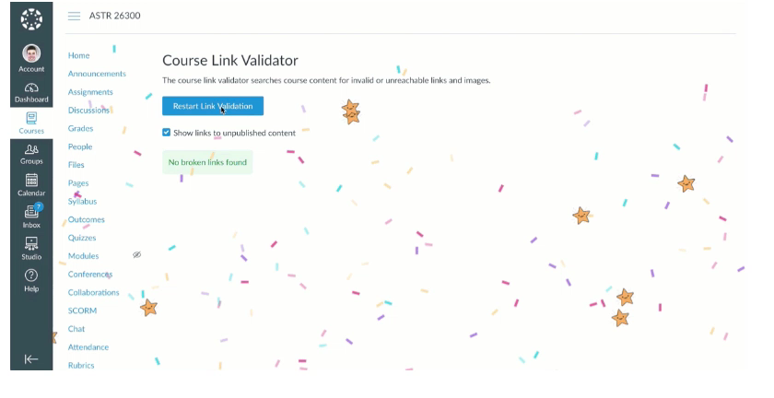
Link validator celebration

Slide 3
DocViewer (SpeedGrader) – Student notification
Students are notified when comments have been added in DocViewer.
Students won’t receive notification till an assignment is posted.

Slide 4
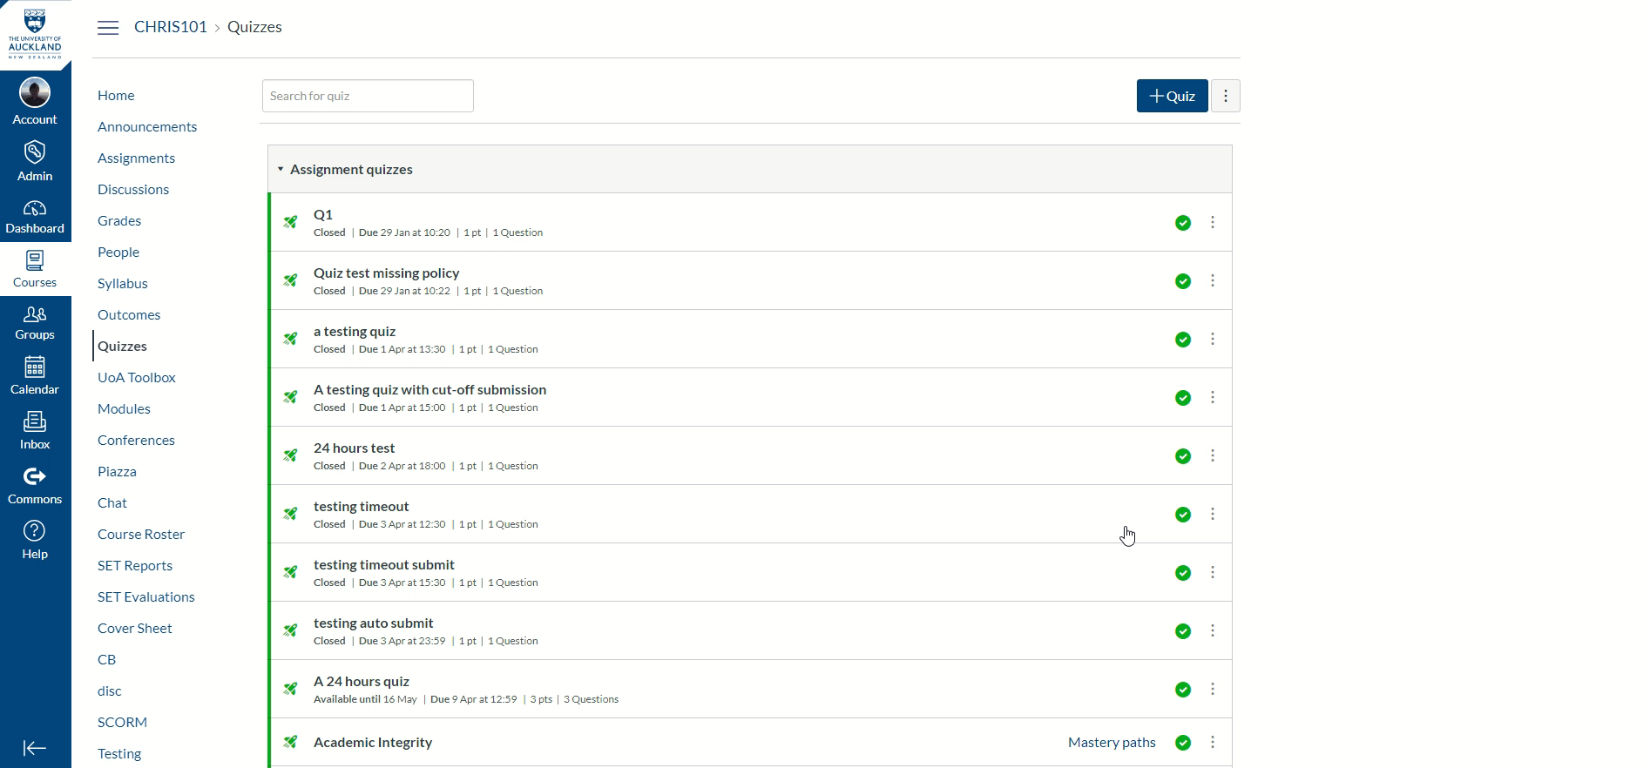
Mark by questions

Slide 5
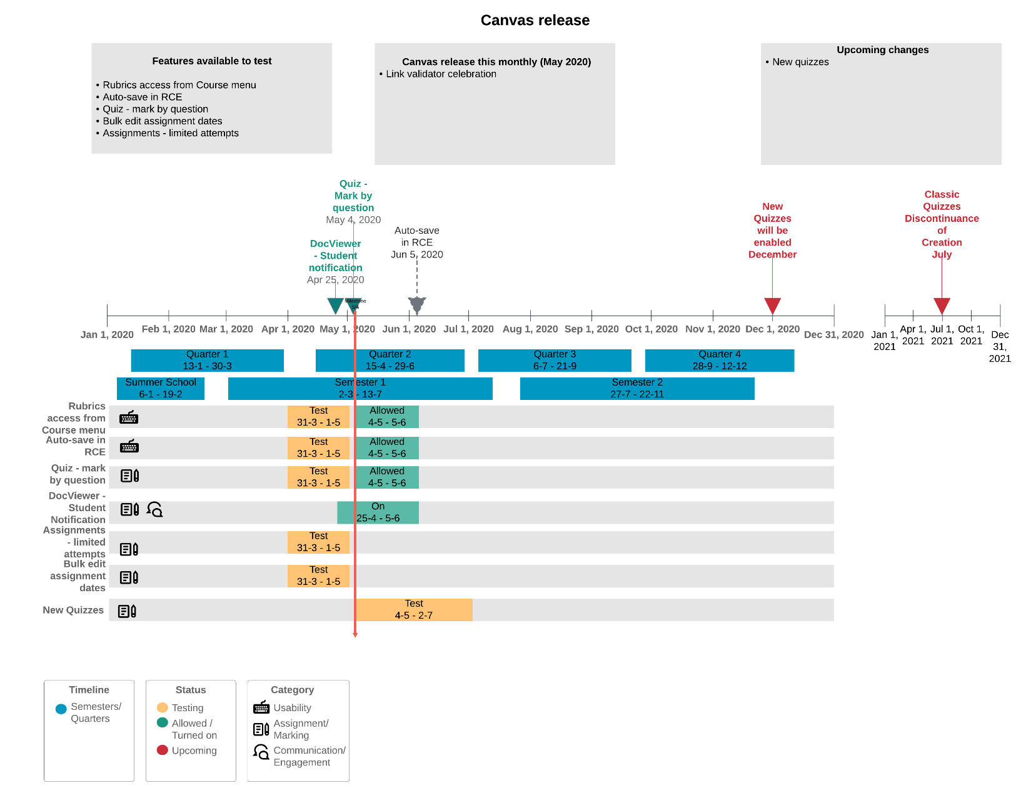
Canvas release timeline

Slide 6
Questions

