Slide 1
Lecture Recordings & DCO
Canvas Townhall

Slide 2
Mediastore Stats
Lecture recordings and uploads to mediapublish.ac.nz

Slide 3
Mediastore Stats
Page views of uploads to Mediapublish.ac.nz by project folder
Project Folder | Count of URLs | Sum of Unique Page Views | Sum of Page Views
2020_STUDYPLAN | 3,942 | 737,921 | 912,103
CMS_SCIENCE | 650 | 129,093 | 208,762
CMS_ARTS | 157 | 15,789 | 20,179
CMS_ENG | 60 | 13,341 | 17,942
CMS_BUSINESS | 66 | 8,944 | 11,021
BUSINESS | 16 | 5,371 | 7,259
CMS_LAW | 38 | 5,494 | 7,219
CMS_FMHS | 9 | 3,061 | 3,650
Others | 4 | 2,369 | 3,008
FOED | 20 | 2,094 | 2,959
FOOD_SAFETY | 19 | 1,565 | 1,818
CMS_FOED | 9 | 993 | 1,218
ARTS_1 | 7 | 634 | 796
Report: Top 5,000 rows (maximum)

Slide 4
New LTR Release: 26th May 2020

Slide 5
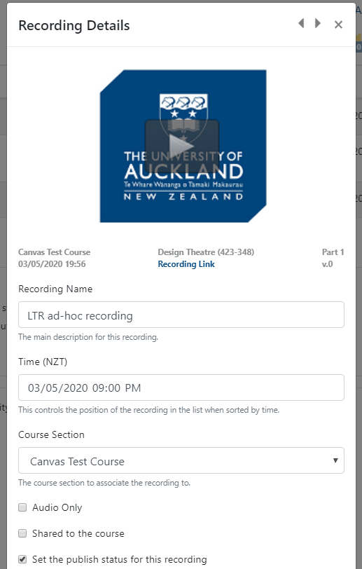
Ad-hoc recording dates
When adding a lecture recording from a previous term they would display at bottom of Recordings list due to sorting by date
[New] Defaults to current date and time – can be updated before saving or edited later

Slide 6
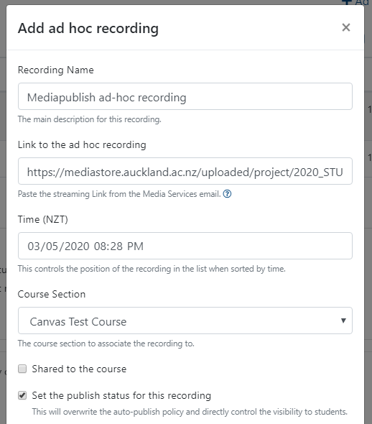
Ad-hoc recording
Previously only able to add lecture recordings captured via LTR process as ad-hoc recordings
[New] Ability to paste in mediastore links from content uploaded to mediapublish.ac.nz
[New] Defaults to current date and time – can be updated before saving or edited later
Sort order – newest date/time at top:

Slide 7
Play recording in new tab
[New] Recordings tab in Canvas has been updated so that clicking on play icon or image will open video in new tab

Slide 8
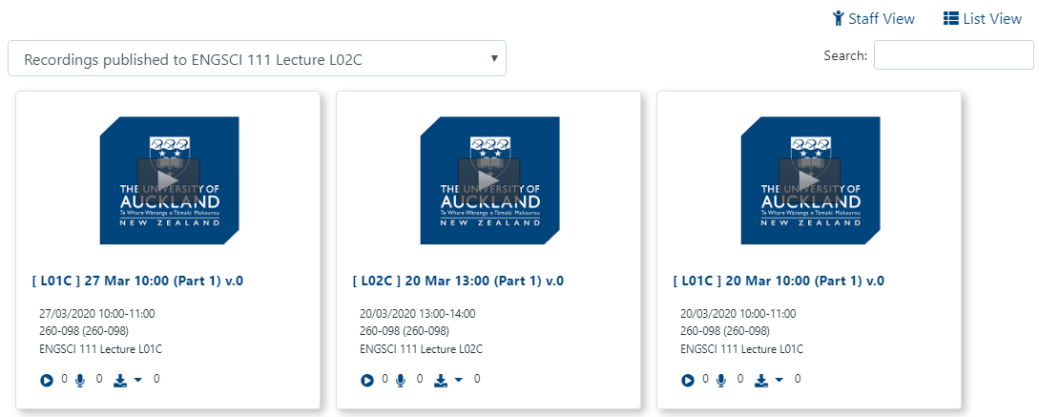
Shared recordings
Recordings that have been shared to other sections not reflected in ‘student view’ for Staff (e.g. if all L01C recordings have been shared with L02 section)
[New] Displays all published recordings for selected section

Slide 9
Digital Course Outline
Semester 2 reminders and upcoming release

Slide 10
Key Dates 2020 Course Outlines
Semester 2
Course Director email notification: 15th June 2020 (due: 6th July 2020)
Reminder notification: 29th June 2020
Canvas Courses published by 13th July 2020 (2 weeks before Semester 1 start).
DCO Canvas integration will be piloted with nominated courses.
Note: Course outlines that have not yet started or editing course outline will get reminders sent to editors/course directors. We will also include any outstanding Quarter 3 and 4 course outlines.

Slide 11
S2 Progress
Semester 2 course outlines
297 published out of 1498 total
445 have started editing, 691 not yet started
Status | Arts | Business | CAI | Education | Engineering | Law | FMHS | Science | Grand Total
New | 129 | 52 | 52 | 75 | 92 | 37 | 48 | 206 | 691
Editing | 123 | 50 | 46 | 24 | 42 | 13 | 64 | 83 | 445
Pending Approval | 7 | 12 | 10 | 4 | 2 |  | 40 | 26 | 101
Pending Publishing |  | 8 |  |  | 4 | 2 | 1 | 1 | 16
Published | 37 | 19 | 39 | 39 | 27 | 3 | 34 | 47 | 245
Grand Total | 296 | 141 | 147 | 142 | 167 | 55 | 187 | 363 | 1498
% Complete | 13% | 13% | 27% | 27% | 16% | 5% | 18% | 13% | 16%

Slide 12
DCO 2020 Timeline
May - June (DCO Improvements)
Student/staff search published course outlines
Review approvers – enable FMHS approvers by Subject
June – July (S2 Course Outlines)
Reminder emails about Semester 2 course outlines
Course Outlines published
July - August (Canvas Integration Pilot)
Populate Course Outline tab in Canvas from DCO information
Pilot with nominated courses in Semester 2

Slide 13
Upcoming DCO Release: June 2020

Slide 14
Course Outline Search
Currently only staff who are part of the approval workflow can view course outlines in DCO
[New] Ability for staff to search published course outlines using
[New] Ability for students* to search published outlines
The search box will be visible on published course outline page
*Students with UPI can currently view published course outlines (if provided URL) and will be able to search

Slide 15
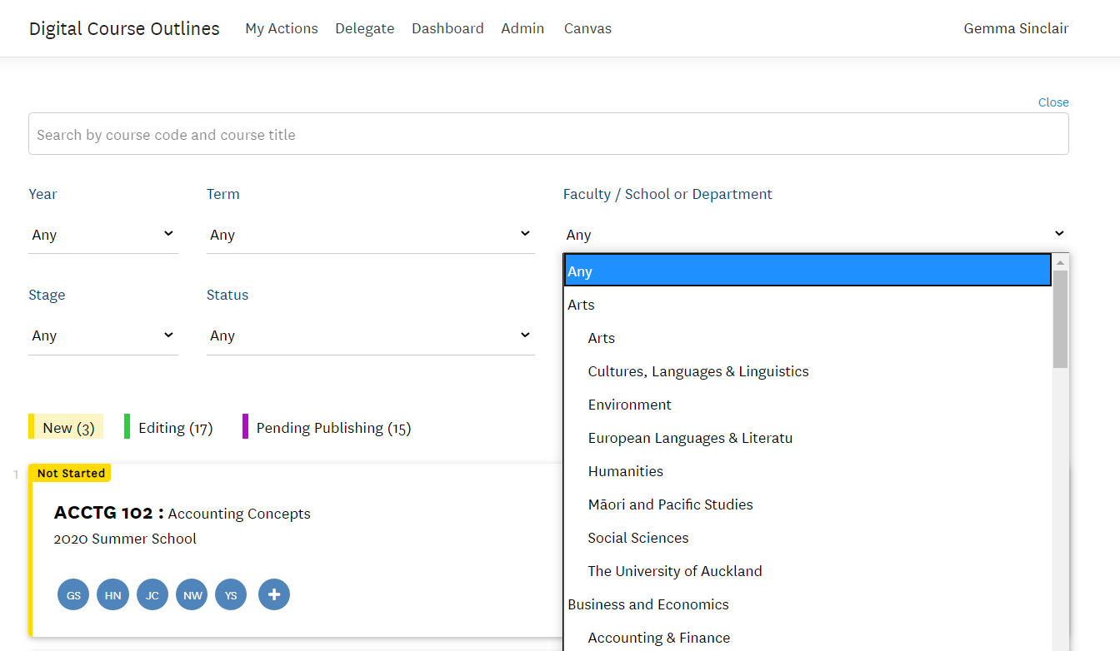
Advanced Search
[New] Year/Term separate drop down options
[New] Drop down for Faculty/School easier to scan

Slide 16
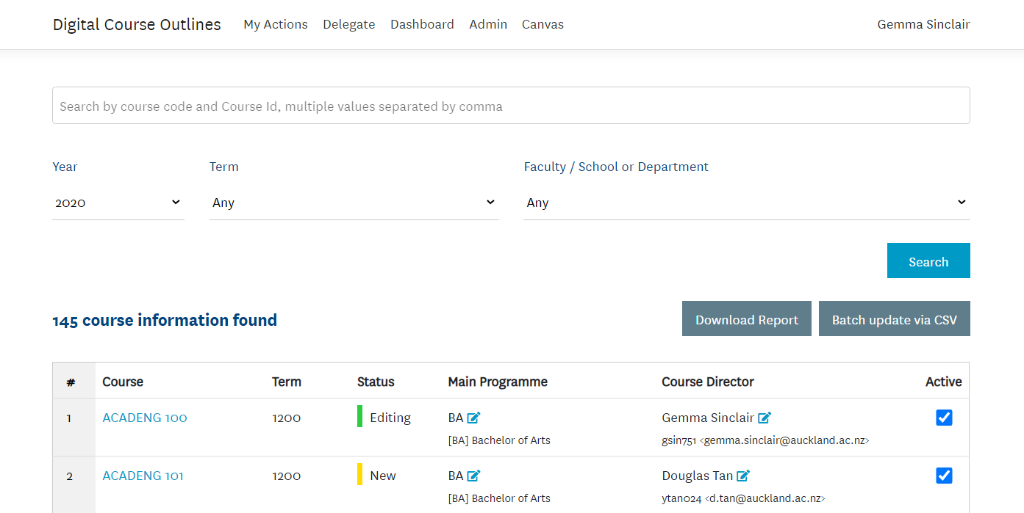
Admin Tab - Enhanced
[New] Year/Term separate drop down options
[New] Batch update button change

Slide 17
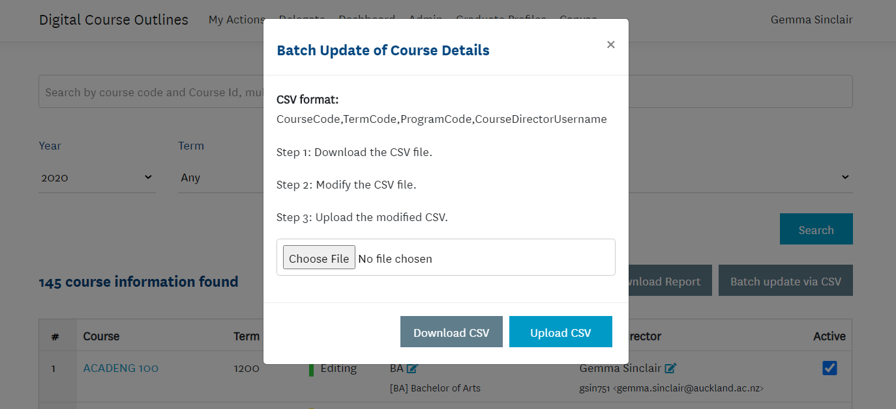
Admin Tab - Enhanced
[New] Batch update now a separate modal window
Previously expanded on the page. Now clearer actions and related activities.

Slide 18
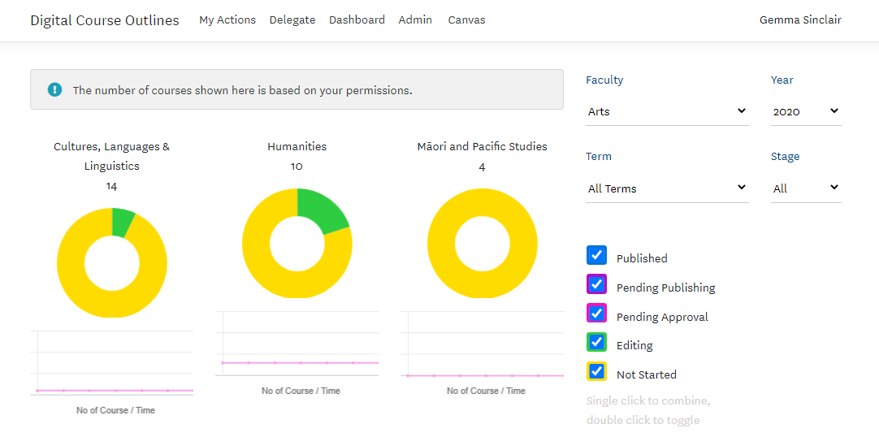
Dashboard - Fixes
[Fixed] Dashboard not loading for some staff
[Fixed] Clicking on category of courses in graphic now displays those courses

Slide 19
Thank you

