Slide 1
Digital Assessments
Inspera Overview & Demonstration
Notes:
Sponsor: John Morrow Business Owner: Kevin

Slide 2
Inspera has more than a decade's experience working as a trusted partner for educational institutions.
Notes:
All Norwegian universities

Slide 3
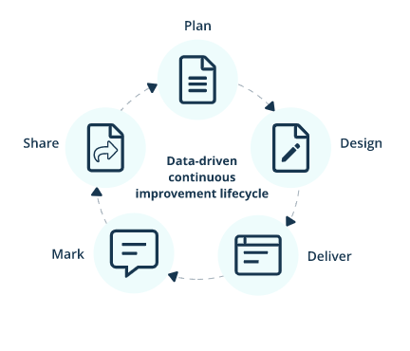
Cloud-based assessment platform that supports examination cycle entirely on-screen, covering the following areas:
1. Plan and schedule assessments
2. Design exam papers, author and bank items, enable aids and access arrangements
3. Deliver online and offline tests and monitor test-takers during the exam
4. Mark and produce feedback*
5. Share results and feedback*
Notes:
Note on * - Examiners are not required to share feedback for exams

Slide 4
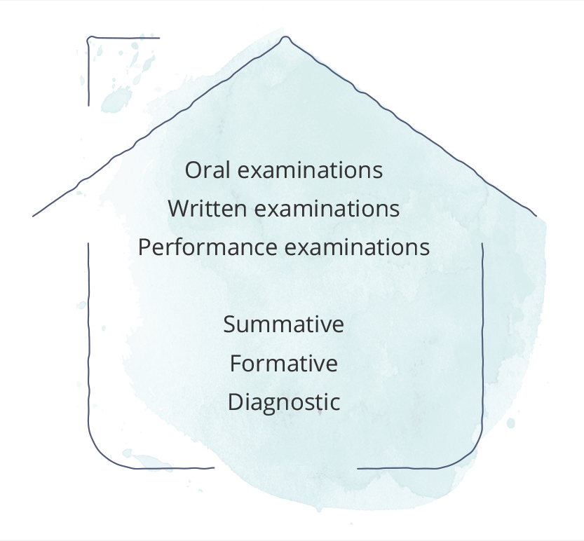
Secure assessments on any device
Inspera Assessment works on all devices, for both open and closed book exams, providing a fair testing environment for every learner.
All forms of assessment under one roof
Create the assessments that you need. Whether it is essay-based assessments in the humanities, or programming and math exercises in STEM.

Slide 5
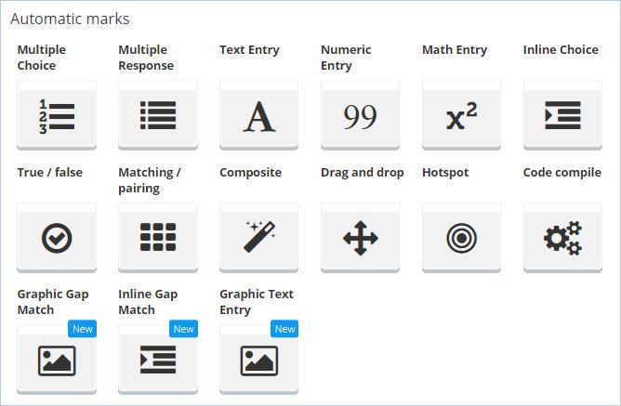
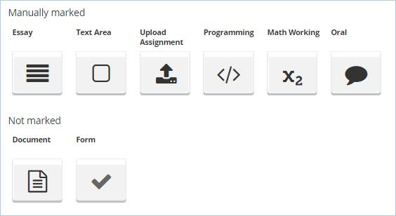
Inspera Assessment offers 23 types of questions, 15 of which are automatically marked.

Slide 6
Exams can be run with Safe Exam Browser (SEB).
Or without Safe Exam Browser (SEB).
Notes:
The student experience –
Safe Exam Browser & not – SEB locks down the exam questions browser to stop student from assessing the internet and content on their computer
One can whitelist sites or tools –e.g. geogebra, calculator, coding
Countdown timer
Main question types – include an example of upload question type
Work is saved every 6 seconds
Time stamped
Online / offline
If internet drops off, student can continue to work offline, once internet comes back on it will sync with cloud and update, if internet remains down at the time of submission it will be saved locally and student will receive prompts to save encrypted file to send to Exams Office when they have internet.

Slide 7
Author
Planner
Monitor
Grader
Notes:
The staff experience
The training modules run by OD – Author, Planner, Grader, Invigilator
Author – example of how a question is created
Planner – settings for start time versus duration
Grader
Monitor – can see if students are online or offline and add extra time for example

Slide 8
Advantages
Time saved with automatically marked questions and online marking and grading.
A significant reduction in printing and associated costs.
A better student experience and ease of pivoting from an on-campus exam to a remote exam in the case of campus closure or an alert level change.
Providing a more consistent experience between our onshore and offshore students.
Very low risk of examination details being inappropriately shared or exposed inadvertently.
Centralised scheduling so examiners don’t need to start the exams.
And there is more
Tested
QTI
In progress
LTI SCANTRON TURNITIN
ANALYTICS
Notes:
Semester 2 pilot: 16 courses Summer School – 15 courses
Semester 1 : Focus on scaling and utilising complex questions and other integration functionalities on Inspera Courses which should consider Inspera: - Text-based exams - Multiple choice - Language exams

Slide 9
More helpful information
Inspera Sharepoint Site
Interested in joining the journey email us at
secure.assessments@auckland.ac.nz

