Slide 1
DCO & Panopto Video Platform
Canvas Townhall

Slide 2
Digital Course Outline - Update

Slide 3
DCO Process
Submit & Publish Course Outline
Export Course Outline
Publish Canvas Course
Staff
DCO
Canvas
SSO
View Published Course Outline
Enrol in Course
View Canvas Course + Outline
Students
Notes:
SSO = Student Services Online

Slide 4
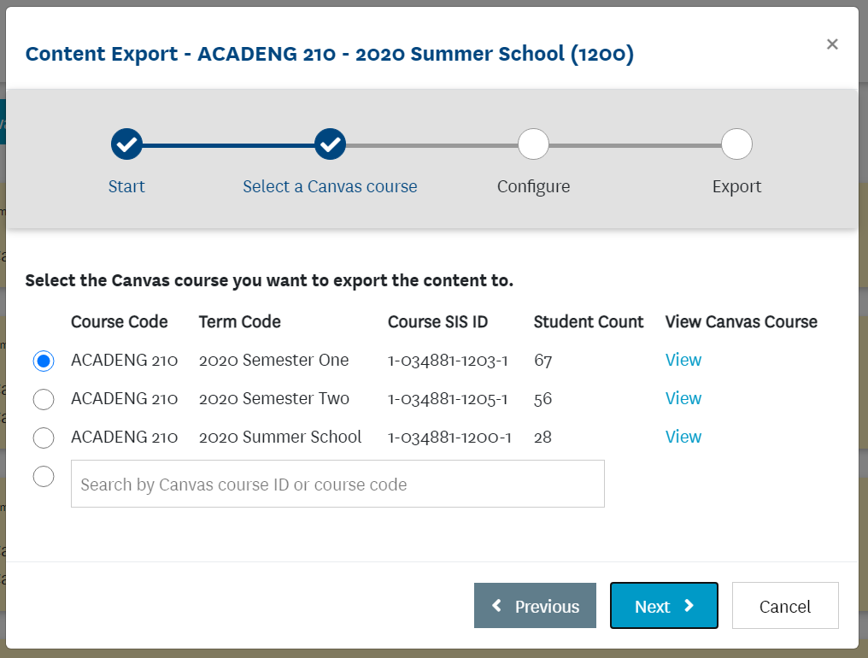
Export Course Outline
Export to Canvas option is available in published Course Outlines for Course Directors and Editors.
The wizard will step through the process to export DCO course outline as an unpublished page in selected Canvas course
Additional information has been added to help identify the correct Canvas course from feedback.

Slide 5
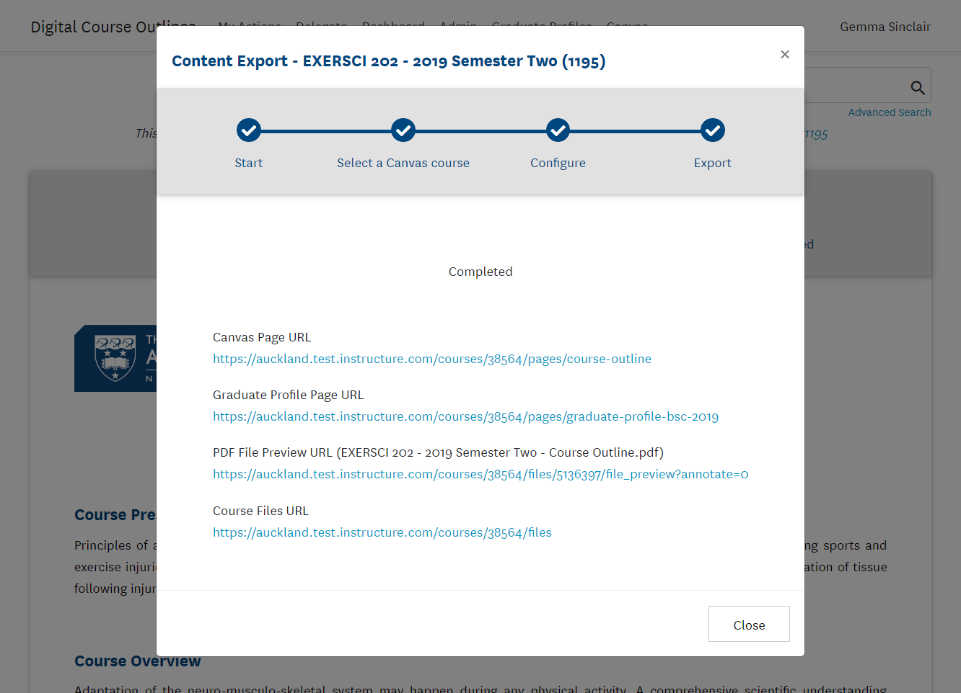
Export Course Outline
Once completed the Canvas course outline page URL is displayed.
The course outline page is unpublished in Canvas.
Graduate profile and Class Reps pages will also be created
If selected, a copy of Course Outline PDF will also be copied to the Files section in Canvas course

Slide 6
Export Course Outline
Review and add relevant information then publish the course outline page
Alternatively, copy the information to the Syllabus page
Suggested additional information:
Teaching details
Class Representatives (once known)
Where to get Help

Slide 7
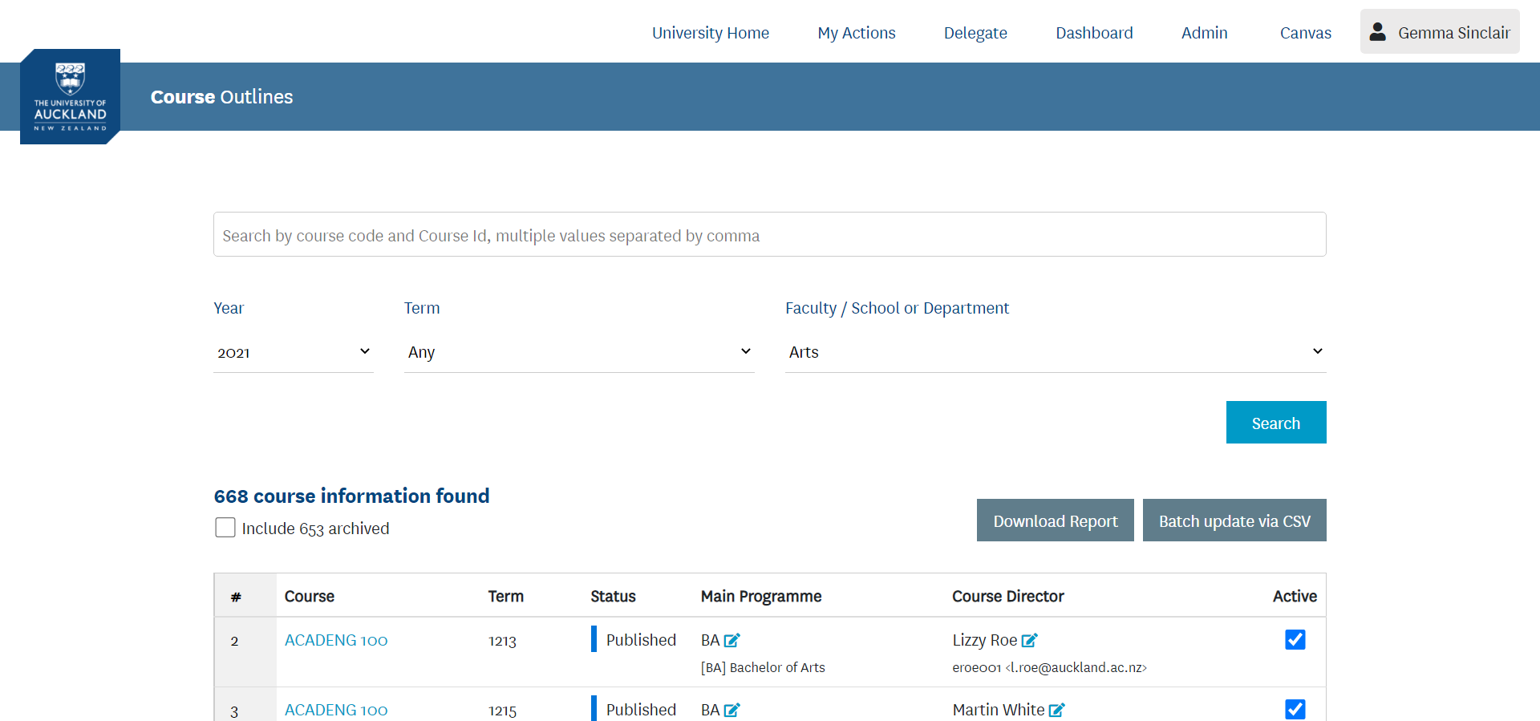
DCO Admin tab
Group Services role can view and edit Course Directors from the Admin tab in DCO.
Option to download report of all Course Outlines in their Department/School or Faculty

Slide 8
2021 Summary
2021 Course Outlines
2604 published out of 3370 total
77% of taught courses have published outlines in DCO
Status | Arts | Business | CAI | Education | Engineering | Law | FMHS | Science | Grand Total
New | 109 | 6 | 8 | 18 | 18 | 34 | 10 | 43 | 246
Editing | 81 | 7 | 10 | 21 | 30 | 12 | 40 | 71 | 272
Pending Approval | 21 | 6 | 3 | 3 | 26 | 2 | 61 | 21 | 143
Pending Publishing |  | 6 | 4 | 1 | 86 |  |  | 8 | 105
Published | 457 | 391 | 375 | 274 | 190 | 84 | 291 | 542 | 2604
Grand Total | 668 | 416 | 400 | 317 | 350 | 132 | 402 | 685 | 3370
% Complete | 68% | 94% | 94% | 86% | 54% | 64% | 72% | 79% | 77%
Updated: 04/07/21

Slide 9
2021 Summary
Semester 2, Quarter 3, Quarter 4 and Late Year course outlines
1158 published out of 1550 total
75% of taught courses have published outlines in DCO
Status | Arts | Business | CAI | Education | Engineering | Law | FMHS | Science | Grand Total
New | 35 | 6 | 4 | 8 | 10 | 17 | 6 | 18 | 104
Editing | 37 | 7 | 6 | 4 | 19 | 6 | 16 | 31 | 126
Pending Approval | 17 | 6 | 2 | 2 | 15 | 1 | 37 | 15 | 95
Pending Publishing |  | 5 | 3 | 1 | 50 |  |  | 8 | 67
Published | 196 | 184 | 162 | 129 | 82 | 28 | 119 | 258 | 1158
Grand Total | 285 | 208 | 177 | 144 | 176 | 52 | 178 | 330 | 1550
% Complete | 69% | 88% | 92% | 90% | 47% | 54% | 67% | 78% | 75%
Updated: 04/07/21

Slide 10
Panopto Video Platform

Slide 11
Panopto
Used by 22 of the top 25 globally ranked universities
Recognised as video content management Leader by Gartner for 4 years running
Award-winning video software for education and learning
Recently launched new AWS Australia/NZ data centre in in Sydney
Notes:
Business case approved and currently working through procurement. Next steps will be to test the Panopto LTI in Canvas.
The market can now provide an effective cloud solution with features that surpass the existing bespoke solution which has components moving into sunset state.
Panopto is used over 600 Universities globally, including AUT, Victoria and Lincoln in NZ. Their Support Office in Sydney

Slide 12
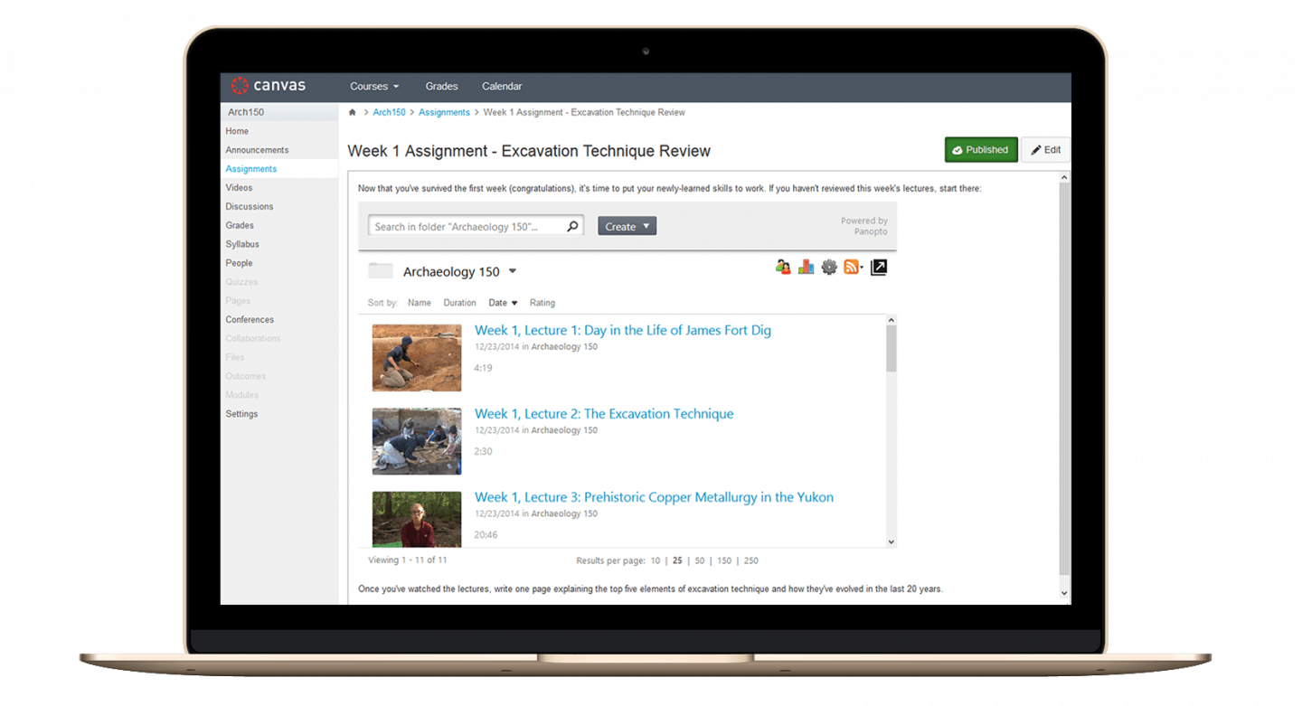
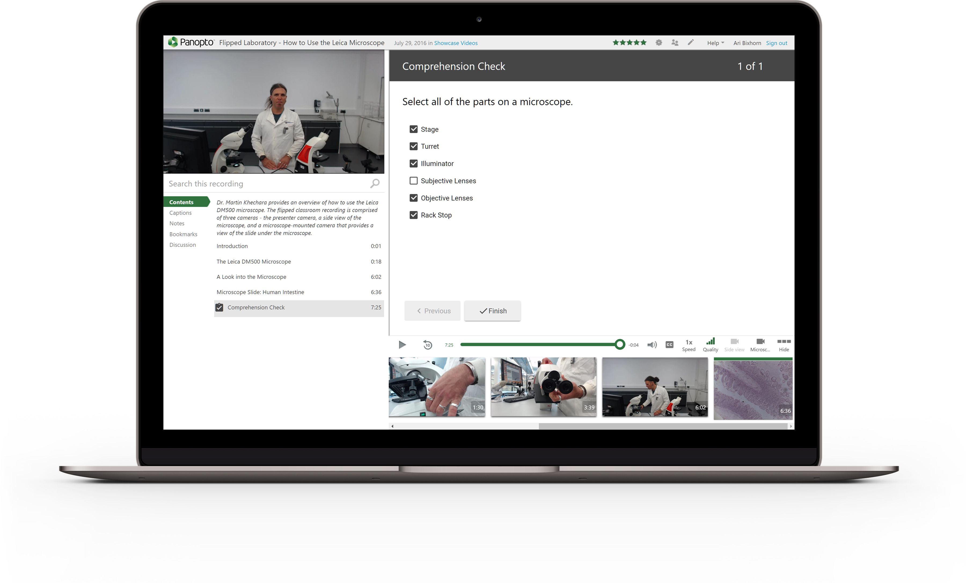
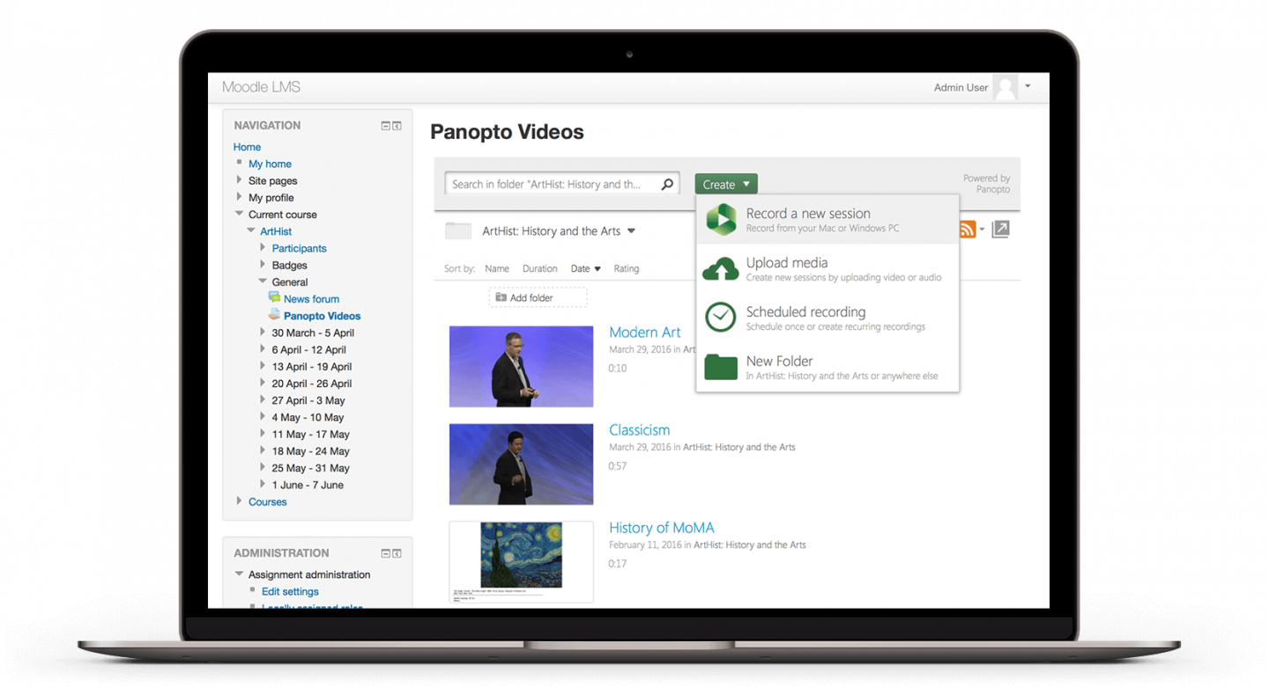
Panopto Features
Canvas
Integration
Flipped Classroom
Lecture Capture
Video Analytics
Notes:
Canvas integration via LTI. Panopto also has Zoom integration and are working on Teams integration.
Flipped Classroom is the ability to record content outside of lecture theatre and edit/publish video content for students to consume before an active session.
Lecture Capture – publish lecture recordings to Panopto. This requires two phases of integration with our lecture theatre recording systems.
Video analytics – measure engagement with video content

Slide 13
Recording Content
Notes:
Currently teaching staff record video content using Zoom, then edit the recordings using Windows Movie Maker or BB Flashplayer, then upload the video to mediapublish site, then wait for an email and copy the published video URL as an ad-hoc Recording in Canvas.
With Panopto you can record from on your device – laptop/PC/mobile with the option of also capturing webcam as well as slides.

Slide 14
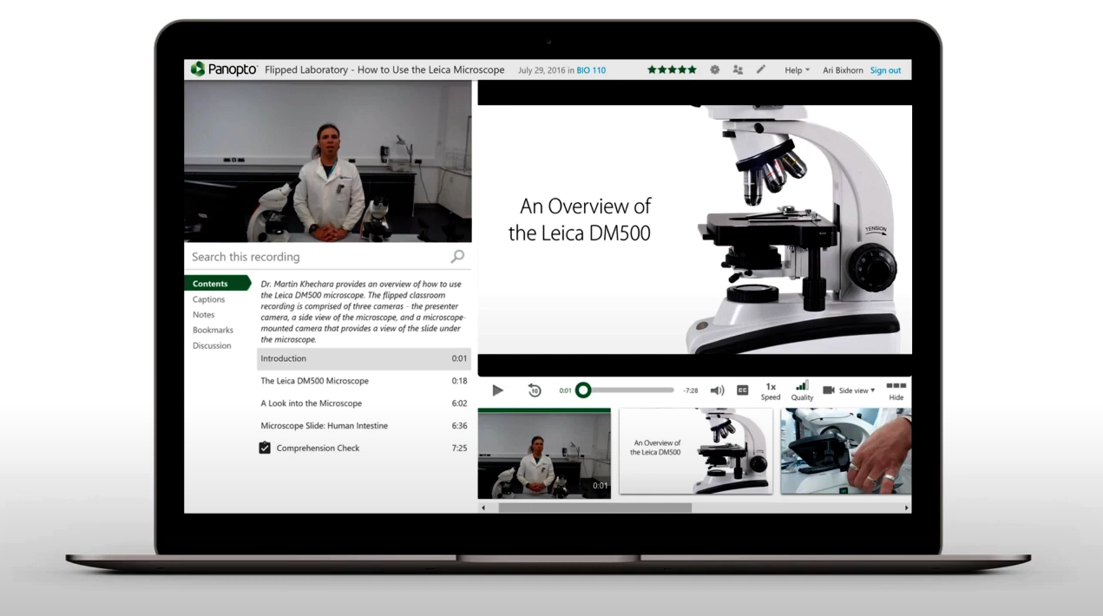
Automatic Indexing
Notes:
When you capture or upload a pre-recorded video into Panopto the system uses Automatic Speech Recognition (ASR) and Optical Character Recognition (OCR) technology to automatically index and time-stamp every word that’s spoken or displayed on-screen. Panopto also uses Slide Content Ingestion to index the PowerPoint or Keynote presentation slides.

Slide 15
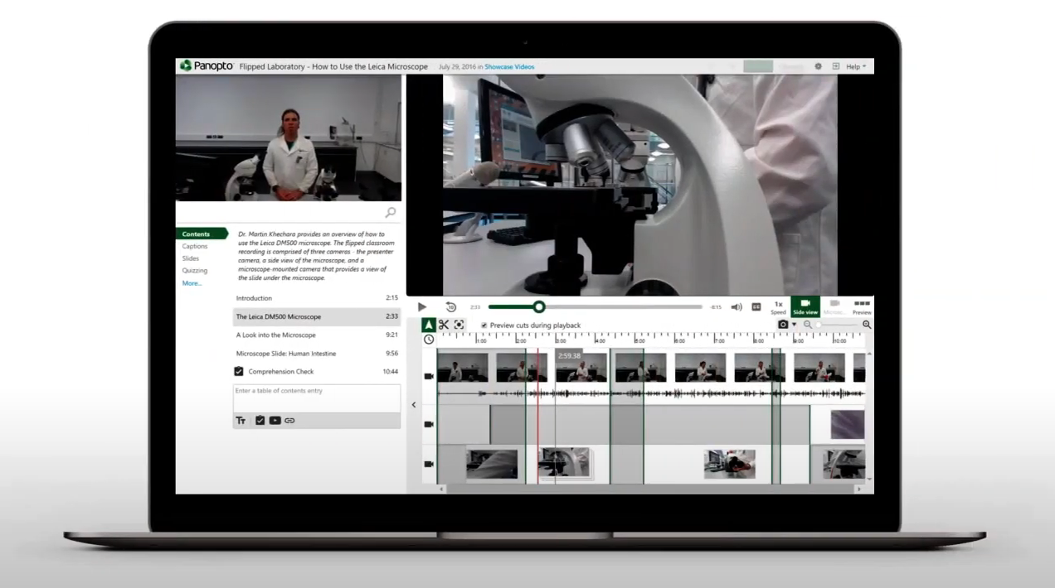
Video Editing
Notes:
Instead of using another tool to edit the recording there is an inbuilt editor in Panopto

Slide 16
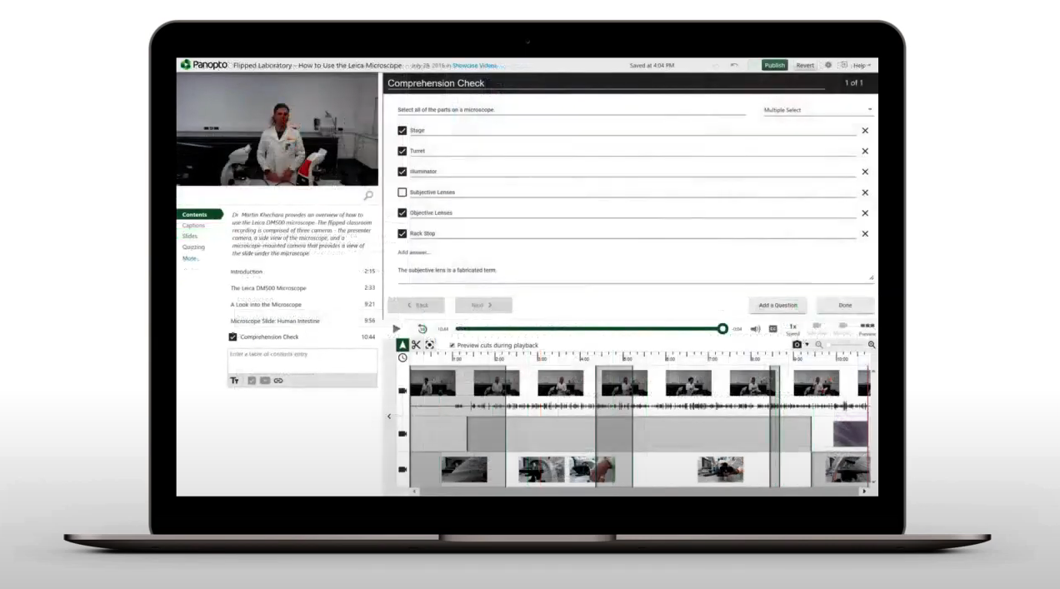
Interactive video quiz

Slide 17
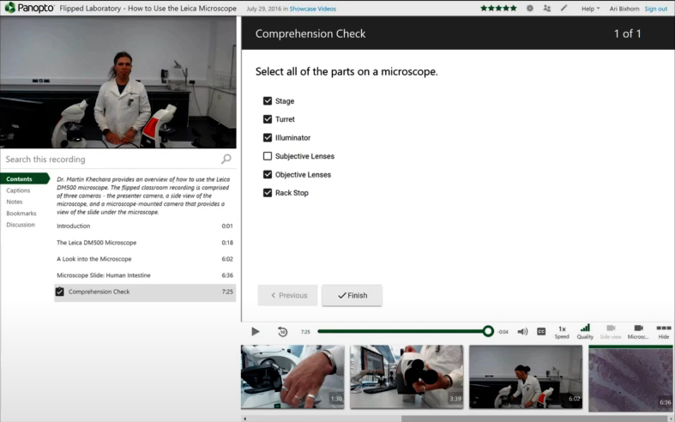
Interactive video quiz
Notes:
You can also create knowledge checkpoints in your video and make the content interactive

Slide 18
Smart Search
Notes:
Through automated indexing and transcripts, staff and students will be able to search within video content to find the relevant portion of the video.
Students who received audio transcripts for lectures (recorded on Zoom) highlighted that learning was more effective when they could read text at the same time as listening and watching.
Revision was much easier with a transcript particularly the ability to search and revisit specific parts of a lecture.

Slide 19
Implementation Steps
Enable Panopto LTI for Pilot courses – TBD, Semester 2, 2021
Nominated courses across Faculties and Departments
Record, edit and publish video content using Panopto in Canvas
Lecture Recordings Integration Development – TBD, 2021
Integration to push lecture theatre recordings to Panopto
Lecture recordings automated transcripts and captions pilot
LTR Transition to Panopto – TBD, 2022
Enable LTI for all courses
Automatically publish lecture recordings to Canvas via Panopto
Lecture Recording scheduling tool (Panopto on LTR Podium)
Notes:
At this stage the contract is being worked through by Procurement so we are still in early stages.
However the intention is to do a pilot using the Panopto LTI this year during Semester 2. Exact timing TBD.
Lecture recordings integration is also expected to start during Semester 2 – dependent on replacing the current developer vacancy in the L&T value stream.
Best Case scenario we would be looking to enable the LTI and have the lecture recordings available in early 2022.
Phase 3 of the implantation is replacing the current lecture recording scheduling system which is significant. The outcome of this will be a Panopto interface on the lecture theatre podium sometime in 2022

Slide 20
Panopto LTI Pilot
LTI Capability
Teaching staff record, edit and publish video content using Panopto in Canvas
Video assignments where students record, edit and submit video using Panopto in Canvas
Automated transcripts
Video analytics and engagement
Evaluation
How easy is it to use Panopto for Flipped Classroom?
How well does automated transcription work for range of accents?
Managing student expectations for automated transcripts and trialing different processes to review and update transcripts
Notes:
Automated transcripts will be in English for all courses (only able to select one default language)

Slide 21
Panopto LTI Pilot
Nominations
Looking for nominations from courses from different disciplines and teaching practices from all Faculties
Looking for range of different accents and voices to review the automated transcription accuracy
Email any nominations/suggestions
I’ll also be asking Assoc Deans, CDMs and BRMs
Timeframe
During Semester 2
Panopto LTI needs to be tested by L&T team before enabled for pilot courses
Process
Demo session with nominated courses
Panopto LTI will be enabled at individual course level
Feedback sessions and survey

Slide 22
Thank you

