Slide 1
Assessment Design and Academic Integrity
Using the Former to Optimise the Latter in
Uninvigilated Online Tests and Exams
AP Jason M Stephens
Faculty of Education and Social Work
Academic Integrity Advisor
6 September 2021
CANVAS Monthly Meeting

Slide 2
Agenda
Introduction
Welcome, Thank you, and Disclaimer
Two Suppositions (related to academic integrity)
Cheating is “natural” and assessment security “imperfect”
Three Goals (for assessment design)
Promote integrity, reduce opportunity, detect misconduct
Conclusion and Discussion
My closing thoughts and your questions/comments/concerns!
Notes:
Disclaimer = expertise understanding why students cheat and how we might cultivate AI – particularly from the perspective of social-moral development
I’m not an expert in assessment or assessment design, and prob didn’t think anymore about much like the rest of my colleague

Slide 3
Two Suppositions
related to academic integrity
Cheating is “natural” and
assessment security “imperfect”

Slide 4
Four Suppositions about Cheating
It’s natural and
a product of evolution; a genetic predisposition
normal, but
typical across species and part of human development
unethical and
it’s deceitful, dishonest and unfair
evitable
education, culture and context matter: B=f (P, E)
Stephens, J. M. (2019). Natural and normal but unethical and evitable: The epidemic of academic dishonesty and how we end it. Change: The Magazine of Higher Learning, 51(4), 8-17. https://doi.org/10.1080/00091383.2019.1618140

Slide 5
Our Dual Natures
We are all genetic chimeras, at once saints and sinners, champions of the truth and hypocrites — not because humanity has failed to reach some foreordained religious or ideological ideal, but because of the way our species originated across millions of years of biological evolution.
- E.O. Wilson

Slide 6
Seed to Tree: A Metaphor with a Moral
Liberty
Authority
Oppression
Subversion
Fairness
Loyalty
Cheating
Betrayal
Care
Sanctity
Harm
Degradation
Misrepresent and Beguile
Regulate and Restrain
Deception
Morality
Individual Survival and Reproductive Success
Social Success and Group Survival

Slide 7
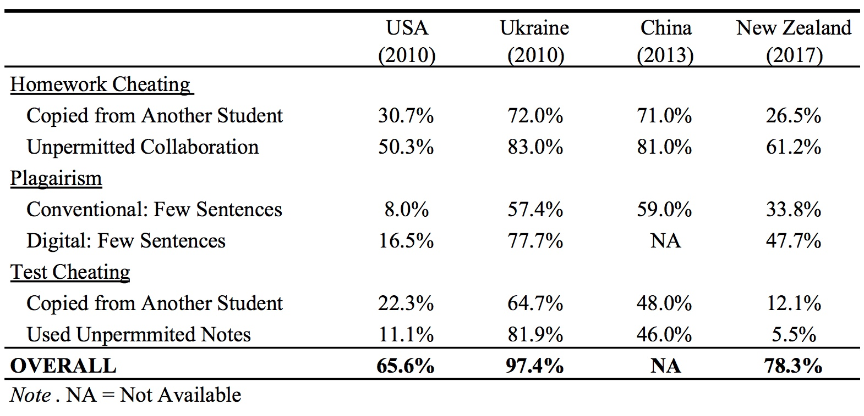
Academic Misconduct Around the World
Ma, Y., McCabe, D., & Liu, R. (2013). Students’ Academic Cheating in Chinese Universities: Prevalence, Influencing Factors, and Proposed Action. Journal of Academic Ethics, 11(3), 169-184. https://doi:10.1007/s10805-013-9186-7
Stephens, J. M., Romakin, V., & Yukhymenko, M. (2010). Academic motivation and misconduct in two cultures: A comparative analysis of U.S. and Ukrainian undergraduates. International Journal of Educational Integrity, 6(1), 47-60. https://doi.org/10.21913/IJEI.v6i1.674
Stephens, J. M., Watson, P.W.StJ., Alansari, M. R., *Lee, G., & *Turnbull, S. (2021). Can online academic integrity instruction affect university students’ perceptions of and engagement in academic dishonesty: Results from a natural experiment in New Zealand. Frontiers in Psychology, 12(366). https://doi.org/10.3389/fpsyg.2021.569133

Slide 8
Assessment Security as “Imperfect”
Perfection as Infeasible
Like cyber-security or airport security, assessment security involves….
Tradeoffs
Security vs. individual privacy, learner experience, test validity, etc.
Security through Obscurity
Phillip Dawson, Prof at Deakin University and Associate Director of the Centre for Research in Assessment and Digital Learning (CRADLE) in Melbourne
Employing un(lesser)known systems
Learn more….
https://www.turnitin.com/regions/apac/integrity-matters/tackling-e-cheating-and-assessment-security-with-phillip-dawson

Slide 9
Three Goals
for assessment design
Promote integrity (before assessments)
Reduce opportunity (during assessments)
Detect misconduct (after assessment)

Slide 10
Promoting Academic Integrity
in Your Courses
On CANVAS and in Class
https://www.auckland.ac.nz/en/staff/learning-and-teaching/academic-integrity/promoting-academic-integrity.html

Slide 11
Academic Integrity Checklist for Course Design
Before the course starts:
Ensure all teaching staff are familiar with University policy/regulations around academic integrity and their responsibility to promote good practice and prevent academic misconduct.
Canvas course pages:
Include links to the University’s Academic Integrity page and Student Academic Conduct Statute in your Canvas course.
Remind students that they need to complete the Academic Integrity course, and why it is important. Link to it in Canvas for students to review the content.
Provide a clear message on where students can get academic support (e.g., Piazza, office hours, tutorials and support websites, such as Learning Essentials) and how often you will check and respond to student queries.
Assessment:
Include the Academic honesty declaration in your assessments.
Make sure assessments are designed to minimise the opportunities for academic dishonesty, e.g. authentic tasks, randomised questions.
Provide rubrics or grading criteria for assessments.
Consider group assessments, with individual components. Ensure that you discuss with students the process and challenges of group work.
Use plagiarism detection software (e.g., Turnitin).

Slide 12
Academic integrity checklist for course design
In class:
Introduce academic integrity in your first lecture, discuss the importance of it with your students throughout the course.
Discuss the different types of academic misconduct with students and provide examples. E.g., some students struggle to see the difference between legitimate collaboration and inappropriate collusion – especially in group work settings.
Explain the grounds for applying for extensions or aegrotat/compassionate considerations to your students.
After the course ends:
Ensure any issues related to academic integrity are discussed and commented on in the end-of-course review.

Slide 13
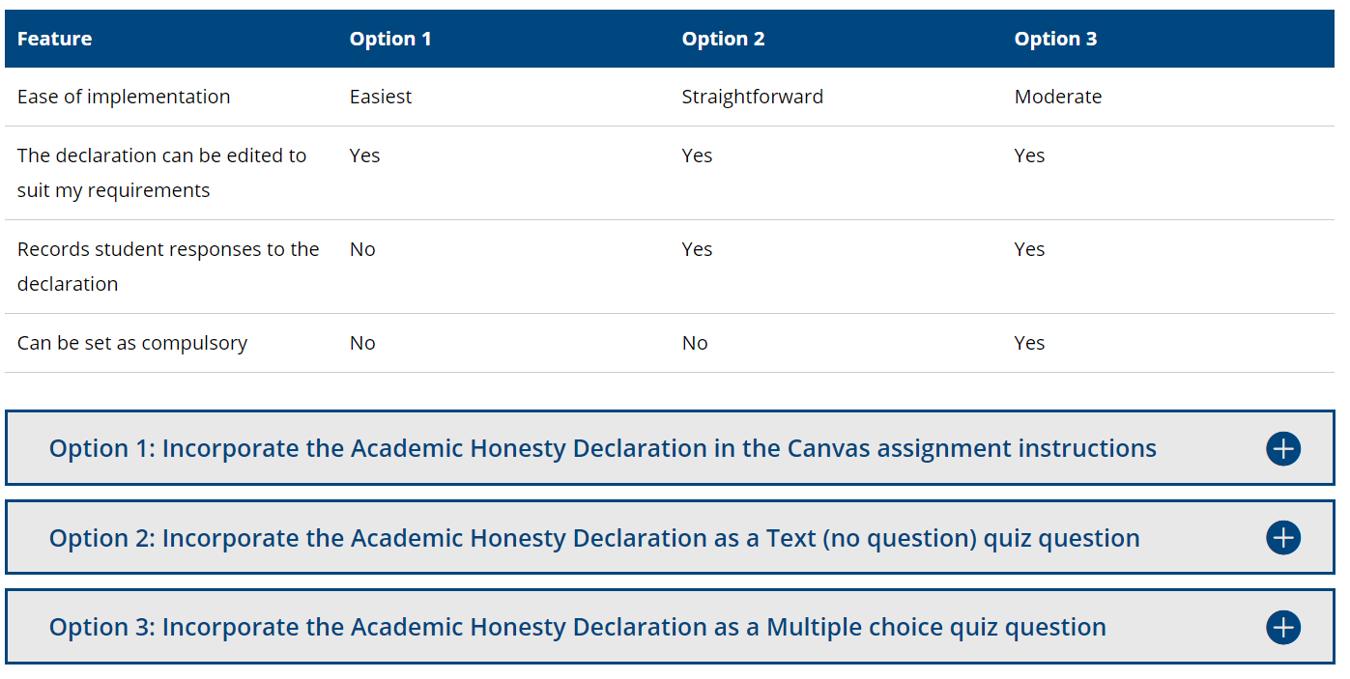
Incorporate Academic Integrity Declaration

Slide 14
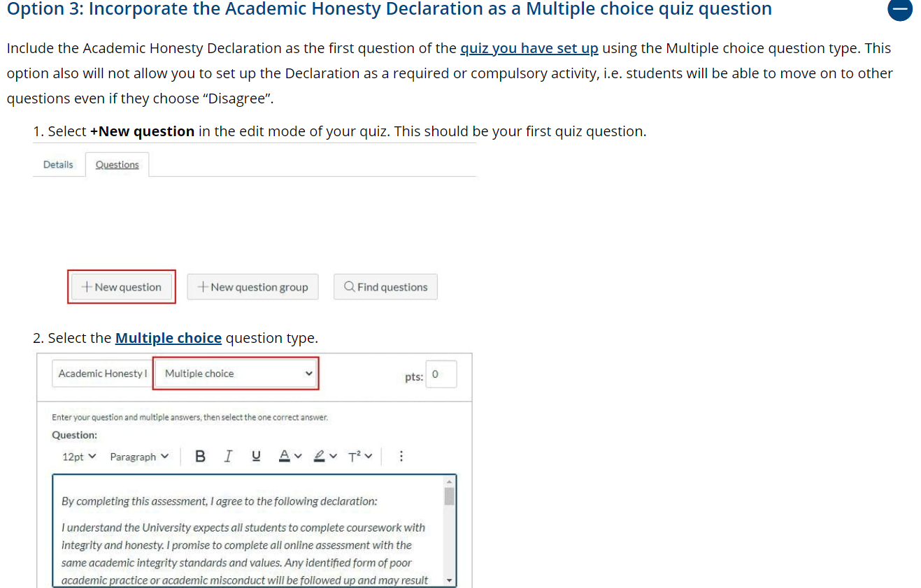
Incorporate academic integrity declaration

Slide 15
Nudge Theory
What is a Nudge?
Nudges are small changes in the environment that are easy and inexpensive to implement.
Change the Default Options
The default option that an individual receives automatically if they do nothing.
Thaler and Sunstein (2008). Penguin Books.
Make it Salient
When an individual's attention is drawn to a particular option, that option will become more prominent for the individual, and he or she will be more likely to choose that option.
Solicit Commitment
Students are less likely to cheat when they have been asked to sign/agree with (or even just read!) a statement/declaration of personal commitment concerning academic integrity

Slide 16
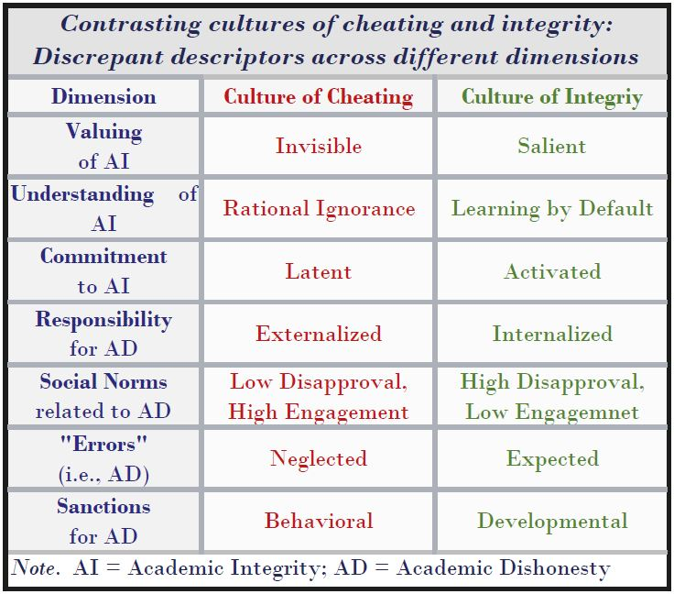
Stephens, J. M. (2019). Natural and normal but unethical and evitable: The epidemic of academic dishonesty and how we end it. Change: The Magazine of Higher Learning, 51(4), 8-17. https://doi.org/10.1080/00091383.2019.1618140

Slide 17
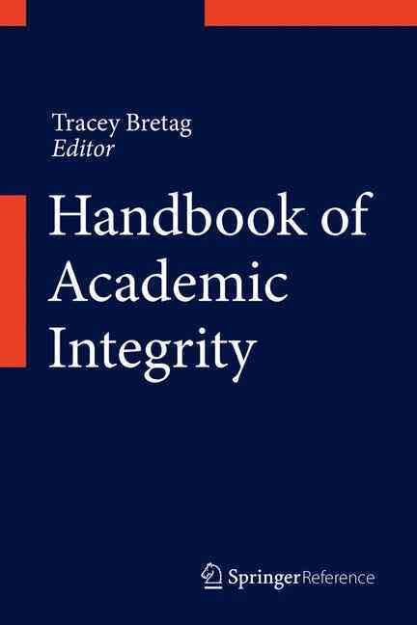
Creating Cultures of Integrity: A three-level model of intervention
Individual Remediation
Immediate and consistent responses to academic dishonesty; Ethical and effective procedures for adjudicating contested cases of misconduct; “Developmental” sanctioning aimed at strengthening understanding of and commitment to AI.
Students
Classroom Prevention
Classroom-based, subject area-specific discussions about the import of integrity and what constitutes dishonesty; Fair and caring instruction and assessment; Real-time, in situ reminders of AI.
Students
and
Teachers
School-wide Education
First Year Orientation Program, Student Assemblies, Student Handbook, Honor Code Reading and Signing Ceremony; School Culture that Promotes Academic Engagement and Honesty.
Students, Teachers, Administrator, and Parents
Stephens, J. M. (2016). Creating cultures of integrity: A multi-level intervention model for promoting academic honesty. In T. A. Bretag (Ed.), Handbook of Academic Integrity (pp. 995-1007): Springer Singapore.
Notes:
Rooted in Cohen and Swift’s (1999) “spectrum of prevention” or other tiered approaches to behavioral and cultural change (Lane et al. 2009; Sugai and Horner 2002), the intervention model presented in this chapter consists of three levels: school-wide education (SWE), context-specific prevention (CSP), and, where needed, individual remediation (IR). In the remainder of this section, each of these levels and their objectives are described in greater detail, and, where possible, concrete examples of their educational applications are provided. Before doing so, it is helpful to say a few words about the structure and substance of the model as a whole.

Slide 18
Three Goals
for assessment design
Promote integrity (before assessments)
Reduce opportunity (during assessments
Detect misconduct (after assessment)

Slide 19
Reducing the Opportunity to Cheat
Three Types of Approaches
1. Change the Rules
There are no rules!
2. Change the Test Items (content)
Make it all HOT!
3. Change the Test Structure (experience)
Be fruitful and multiply!
Open the Book, but not the browser?
Make it Discrete with DOMC
Randomise the Feed – blocks, items, and answers!

Slide 20
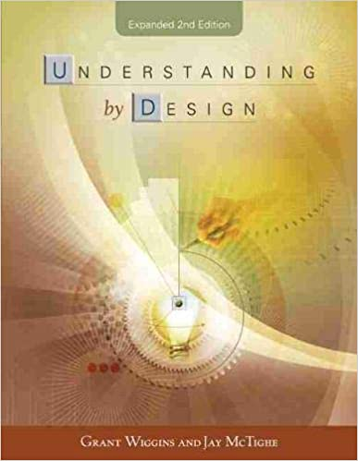

Slide 21
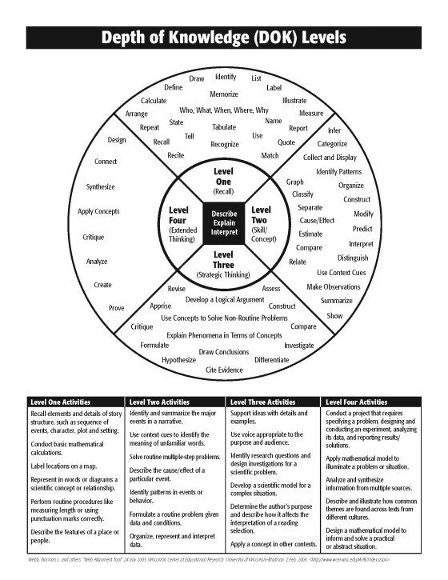
https://www.teachthought.com/pedagogy/assessment-design-matrix-assess-assessments/
Notes:
Retrieved from https://www.teachthought.com/pedagogy/assessment-design-matrix-assess-assessments/

Slide 22
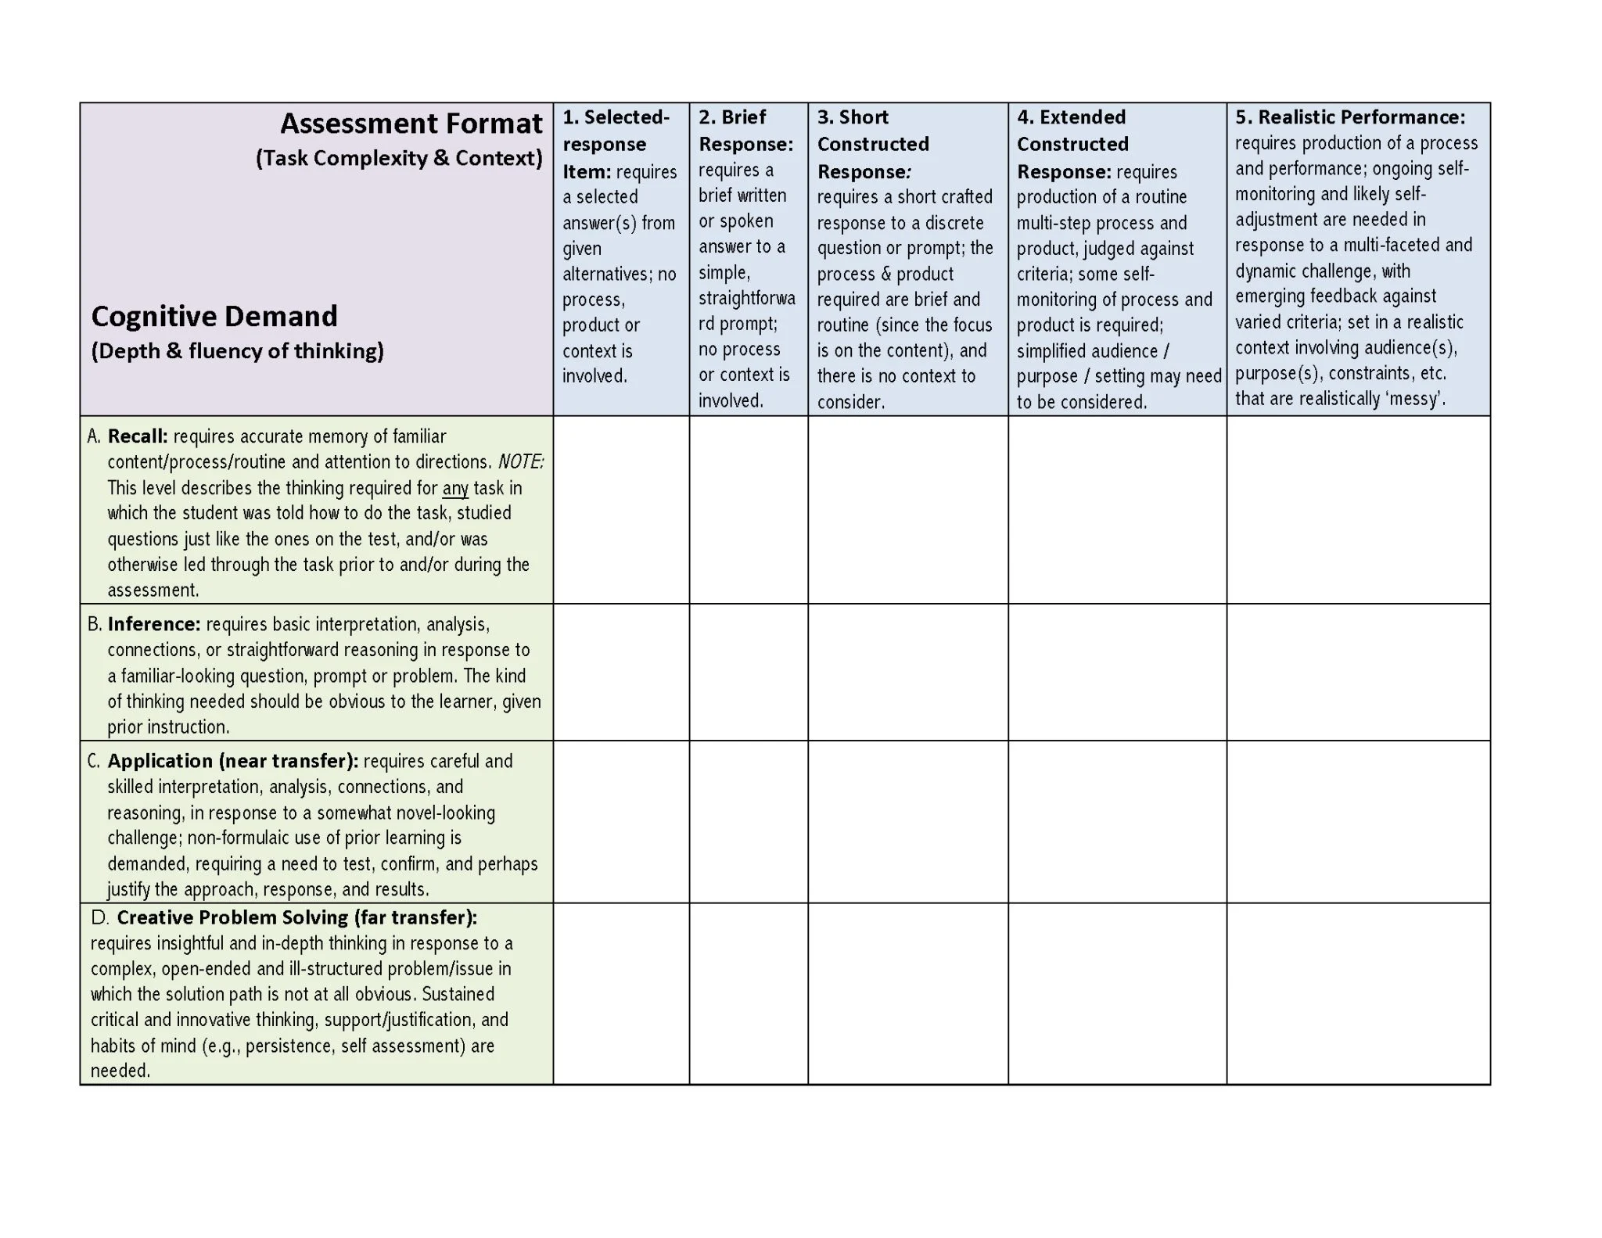
Retrieved from: https://www.teachthought.com/pedagogy/assessment-design-matrix-assess-assessments/

Slide 23
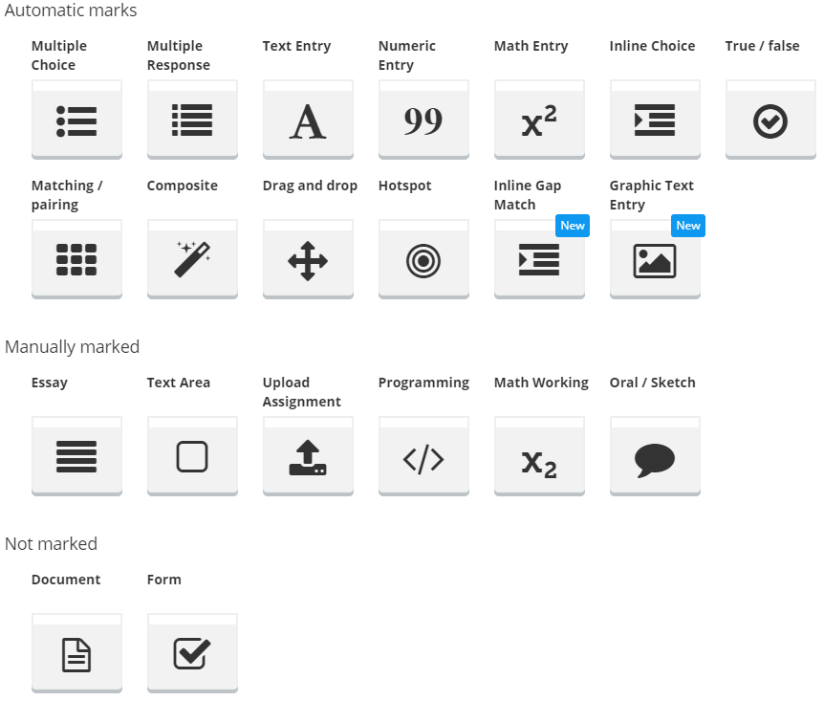
Inspera Question Types

Slide 24
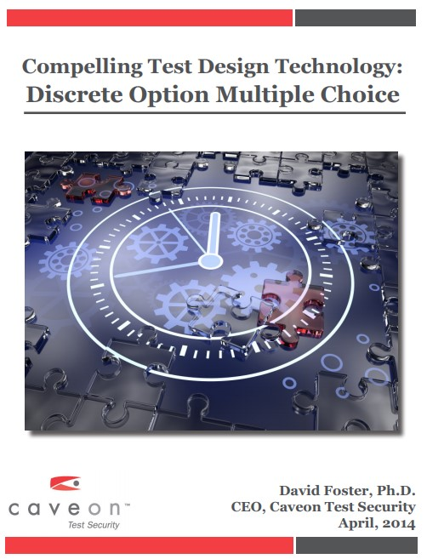
Discrete Option Multiple Choice
What is DOMC?
A relatively simple but very useful change in the delivery of multiple choice item content on computerized tests.
Instead of providing all options at one time, options are randomly presented one at a time along with YES and NO buttons.
For each presented option, the test taker chooses YES or NO as to whether the option is perceived as correct or incorrect, respectively.
When the question is answered correctly or incorrectly, additional presentations of options are rendered unnecessary.
Retrieved from https://www.caveon.com/wp-content/uploads/2014/04/DOMC-White-Paper-final.pdf

Slide 25
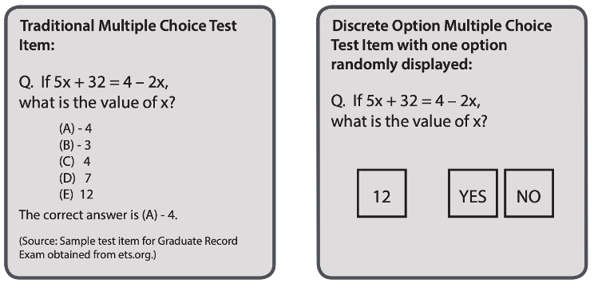
Discrete Option Multiple Choice
Retrieved from https://www.caveon.com/wp-content/uploads/2014/04/DOMC-White-Paper-final.pdf
Notes:
https://www.hyflexlearning.org/2021/07/26/assessment-efficiency-and-effectiveness/

Slide 26
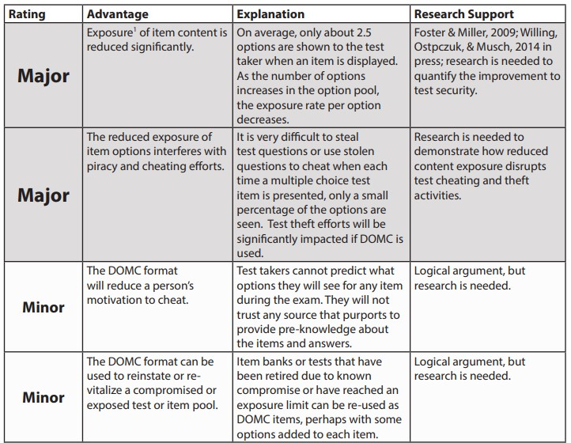
DOMC Advantages Compared to
Traditional Multiple Choice
Security Advantages

Slide 27
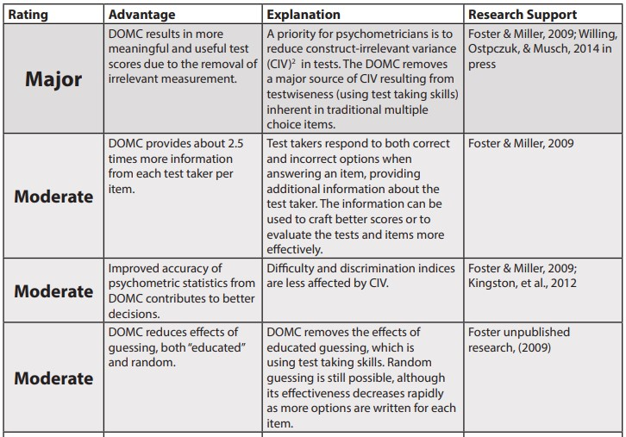
DOMC Advantages Compared to
Traditional Multiple Choice
Measurement Advantages

Slide 28
DOMC Advantages Compared to
Traditional Multiple Choice
Fairness Advantages

Slide 29
Three Goals
for assessment design
Promote integrity (before assessments)
Reduce opportunity (during assessments
Detect misconduct (after assessment)

Slide 30
Technologies Facilitating the
Detection of Dishonesty
Pattern Matching and Recognition
Similarity checking software
Lock down browsers
Keystroke recognition devices
Learning Analytics
Notes:
https://typingdna.com/

Slide 31
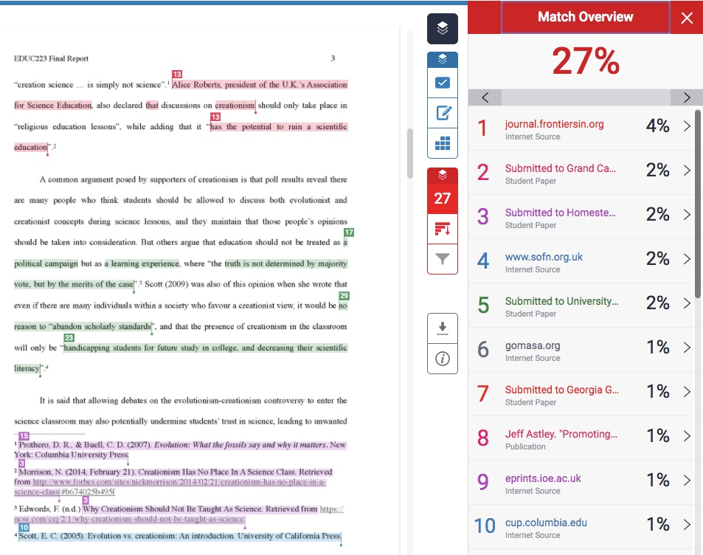
Similarity Checking Software
Example of an Originality Report

Slide 32
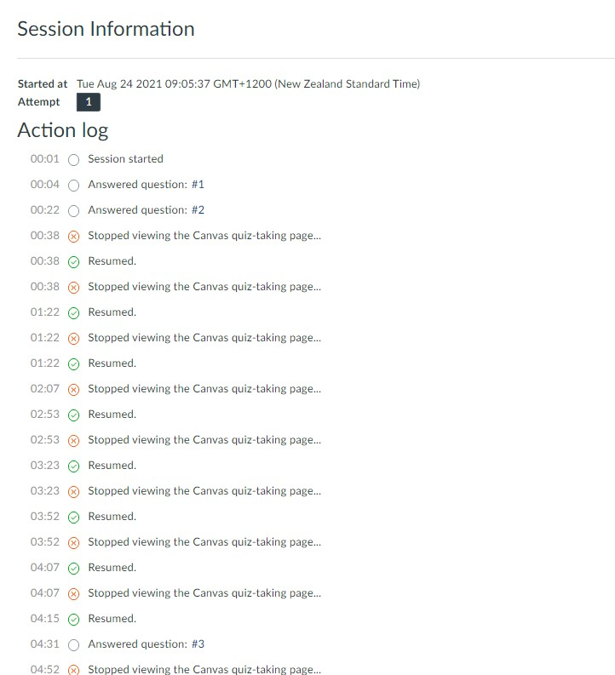
Canvas “Action Log”
Example from my midterm test (two weeks ago)

Slide 33
Concluding Thoughts
The Future is Unwritten

Slide 34
Thank you for your time
and attention…
Questions?
Comments.
Concerns!

