Slide 1
Inspera online exams in Canvas
Canvas & Teaching Technology Meeting
Notes:
Update on Inspera exams which started last week

Slide 2
Inspera Exams
Two types of exams:
495 x Inspera standard exams (students use web browser e.g. Chrome)
28 x Inspera invigilated exams (students download Inspera Exam Portal)
Exams started on Thursday 9th June and exam assignments have been published to students.
Once exam marks are confirmed in Inspera they will pass to Canvas gradebook (the Inspera assignment).
Notes:
The exam assignments were created on 25th May and Course Directors / GSMs notified. Thanks to everyone who published the exam assignments.
Day before exams the team published the remaining assignments as they hold key information for students.

Slide 3
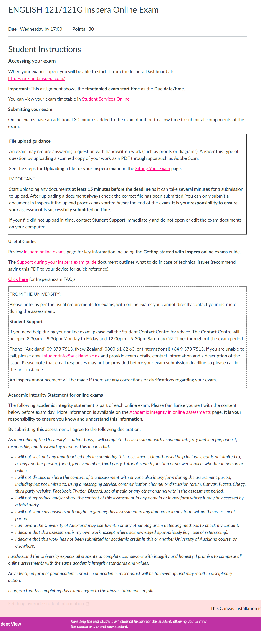
Inspera assignment
The online exam assignment includes important information for students on how to access their exam, guidance on Inspera and where to get support.
The instructions are similar to last years exams. The points have been updated to match the Inspera exam.
Note: Exams which do not include any file uploads can remove this section from the assignment instructions.
Notes:
Assignment information for standard exams. Students access via Inspera website.
Assignments have due date/time as start time for the exam so it appears in student calendar
We have updated the points to match the total marks from Inspera

Slide 4
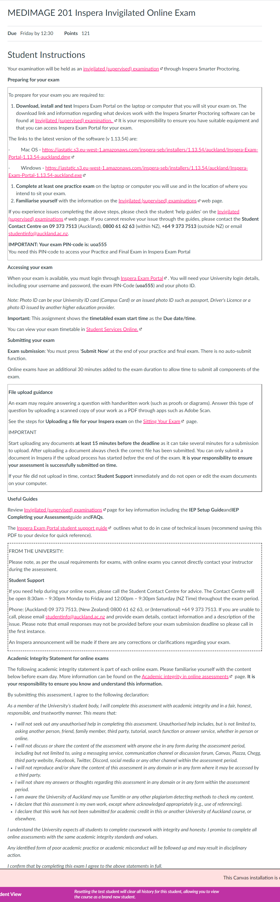
Invigilated assignment
The invigilated exam assignment has different steps for students to prepare and access their exam. Software must be downloaded which will record the students screen and webcam during the exam.
The instructions are similar to last years exams. The points have been updated to match the Inspera exam.
Note: Exams which do not include any file uploads can remove this section from the assignment instructions.
Notes:
Invigilated assignment instructions are different because students need to download Inspera Exam Portal to access the exam.
Students should always use the latest version of the software and complete practice exams to make sure their device and internet connection is compatible.
If students have issues with the software they should contact Student Contact Centre for what to do.

Slide 5
Inspera practice exams
Inspera Practice/Mock exam requirements:
Must close at least 1 day before the scheduled exam
Naming convention to include “Practice” or “Mock” and Course Code e.g.:
“Practice exam PSYCH 109/109G”
Exams Office will check to ensure there is no overlap with scheduled exams.
Inspera External Tool steps:
https://auckland.instructure.com/courses/15995/pages/lti-inspera-setting-up-practice-exam
Notes:
Any practice exams should close at least one day before the scheduled exam

Slide 6
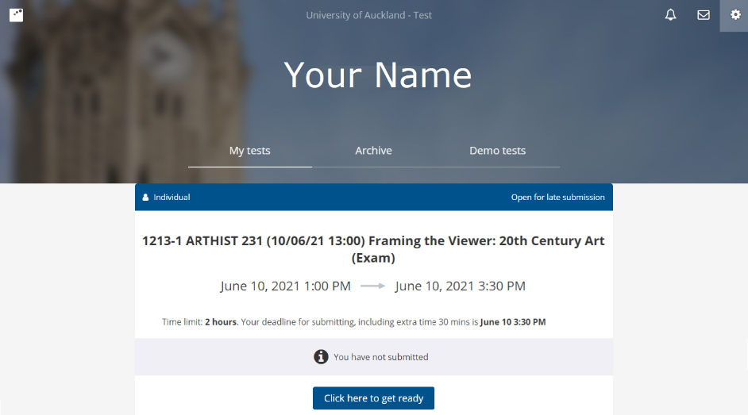
What students will see
From Canvas:
Select Courses
Click Assignments
Open Inspera online exam assignment
Click on Inspera dashboard link
From Inspera dashboard:
In My tests tab
Click the Click here to get ready button
Click the Start test button
Notes:
What students see for standard Inspera exam. They go to Canvas and launch Inspera link.
They will see the upcoming exams (including practice exams) under My Tests
When the exam starts they can click START

Slide 7
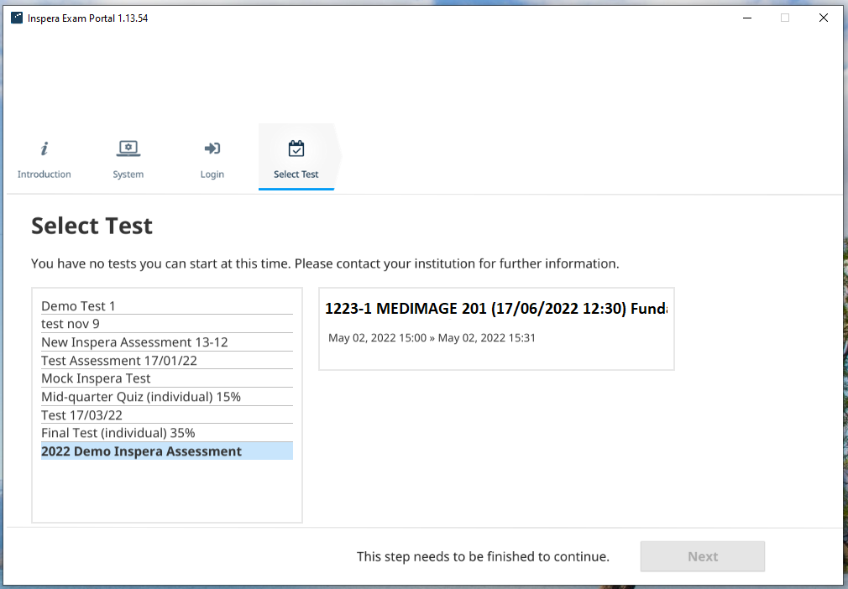
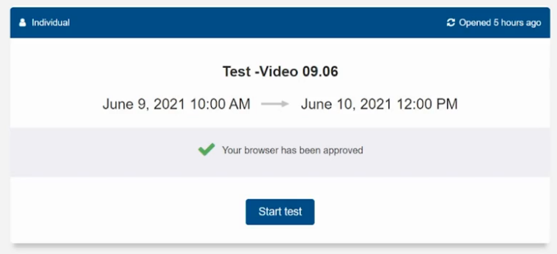
Invigilated exams
From Computer:
Open Inspera Exam Portal (IEP)
Complete the Proctoring checks (connection, app version screen capture etc)
Select the exam from list
Complete micrphone, Photo and ID check
Start exam
Notes:
Students do not go to Inspera website to launch invigilated exams.
They open the software on their computer, complete proctoring checks then login and select the exam from the list of upcoming “Tests” (will see upcoming practice exams as well).
It takes time to do the checks etc, students should do this 15 minutes before the exam start time so they are ready to start on time.

Slide 8
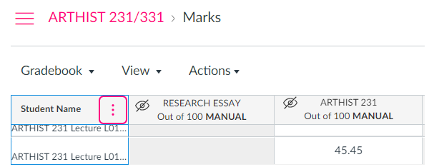
Canvas Grade Passback
Examiner steps
Confirm the marks and grades
Check Canvas Gradebook for updated marks
Note: If confirmed marks haven’t appeared in Canvas Gradebook after 10-15 minutes then log ticket with Canvas Support with course details.
Notes:
Grades will be automatically transferred back to Canvas once marks confirmed. Please ensure all exams are confirmed e.g. if individual students have sat exams at different times they will be separate exams in Inspera

Slide 9
Inspera Support
Inspera Resources
Inspera Support Portal and Inspera Help Centre
Inspera Support
Email: inspera@auckland.ac.nz
Join Zoom Room (1pm – 2pm weekdays during exams period)
Notes:
Inspera support information.

Slide 10
Thank you

