Slide 1
Discussion tools Canvas Discussions, Piazza, and Ed Discussion
Damon Ellis

Slide 2
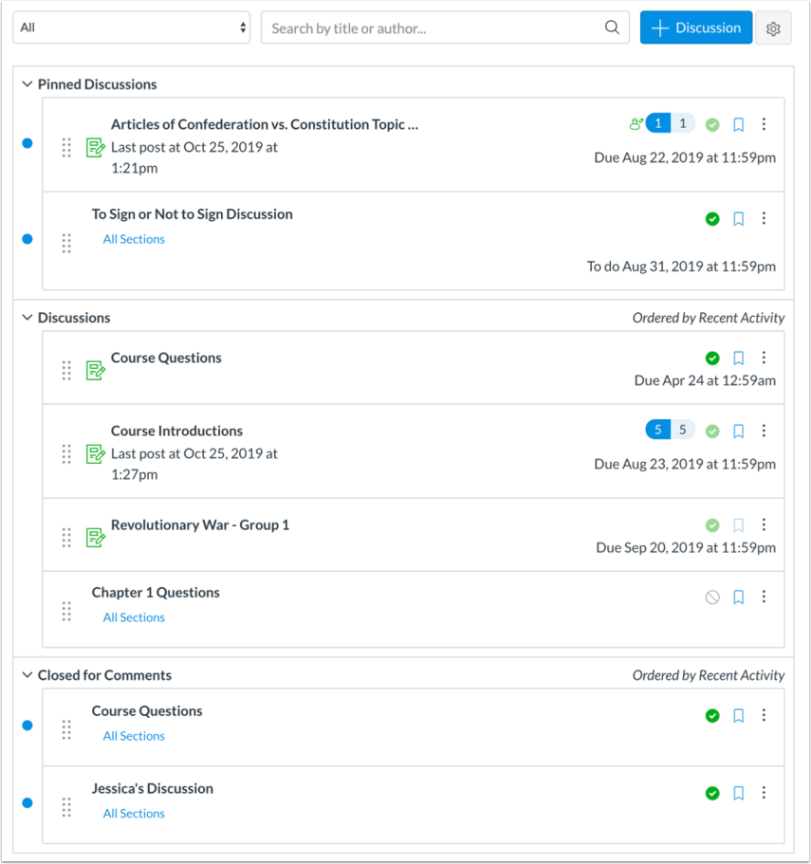
Canvas Discussions
Good for:
Smaller classes
Discursive / sharing / coordination / collaboration
Assessed discussions
Opt-in redesign available now
https://www.canvas.ac.nz/resources/communication-and-collaboration/#discussions

Slide 3
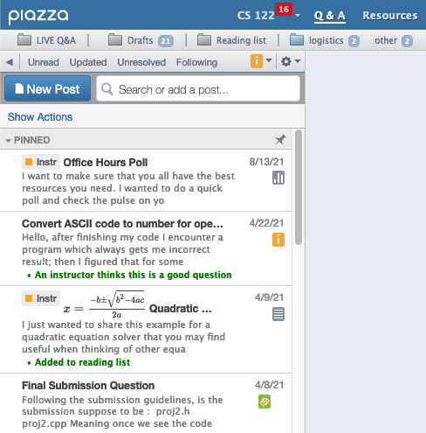
Piazza
Good for:
Larger classes
Q+A
“Live” discussions
(Partial) anonymity
More organised and searchable discussion
https://remotelearning.auckland.ac.nz/overview/core-teaching-tools/piazza/

Slide 4
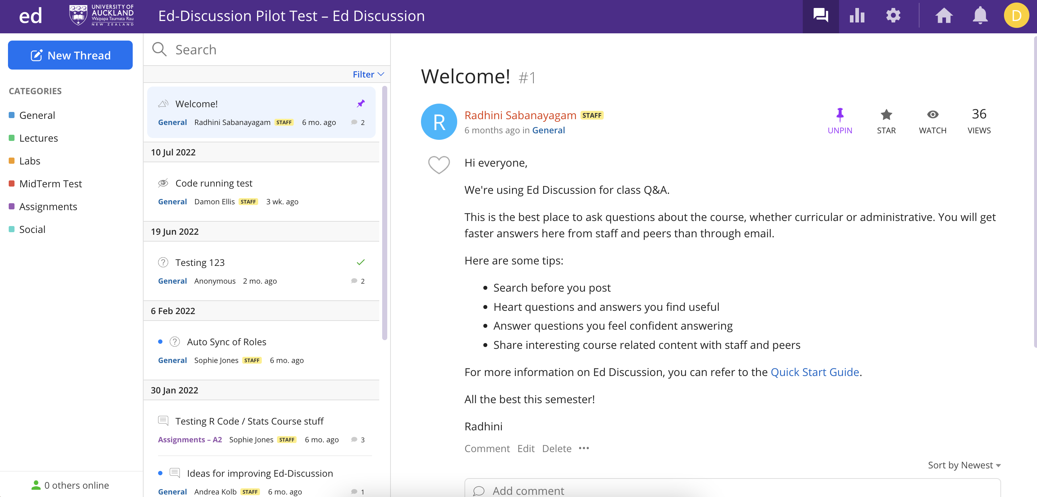
Ed Discussion
Piazza-like experience
Currently being piloted at UoA
https://www.canvas.ac.nz/2022/07/12/ed-discussion/

Slide 5
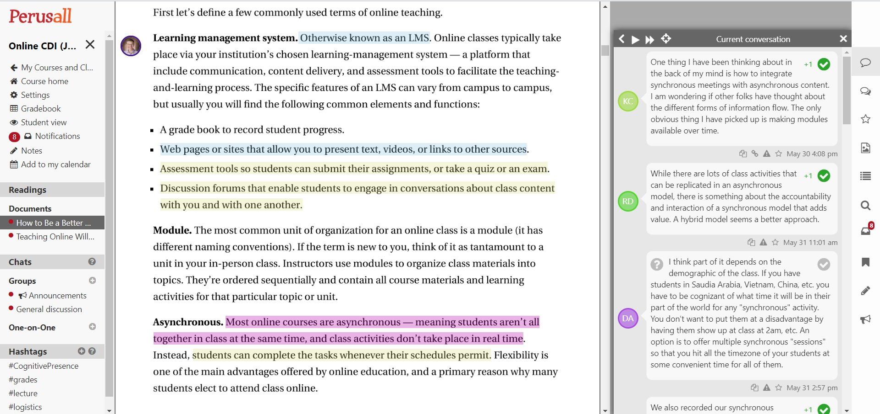
Perusall
Good for:
Discussion of / in readings
Artefact-centred discussion
https://remotelearning.auckland.ac.nz/overview/core-teaching-tools/perusall/

Slide 6
Tips and tricks
Introduce the discussion platform by running a live walkthrough in class or on Zoom
Demonstrate and encourage use of search functions, categories, tagging, etc.

Slide 7
Tips and tricks
Establish expectations
Appropriate uses / shared norms
Teacher responsiveness – daily, weekly, during ”virtual office hours”, within X days, never
Ask permission to transfer emailed questions to the platform.
Link to or endorse student answers rather than replying in detail each time.

Slide 8
Tips and tricks
If the goal is collaboration, prompts must require collaborative effort.
In weekly announcements, give an overview of common themes, thoughts, other details emerging from the discussion.

