Slide 1
Turnitin AI Detection
Canvas & Teaching Technology Monthly Meeting

Slide 2
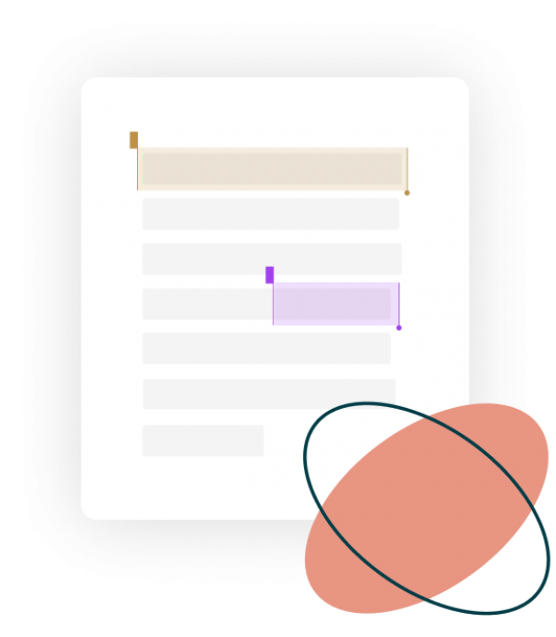
Turnitin – AI Detection
Turnitin has been developing AI writing detection to add to the similarity report in Feedback Studio.
The AI detection is based on GPT-3 & GPT-3.5 and ChatGPT (not yet updated for GPT-4). The AI detection score and report will not be visible to students.
The early release will be available this week on 5th April, however several institutions in UK, AU and NZ have opted out of the early release – including University of Auckland.
More info: https://www.turnitin.com/solutions/ai-writing

Slide 3
Turnitin – AI Detection
‘When a paper is submitted to Turnitin, the submission is first broken into segments of text that are roughly a few hundred words. Those segments are then overlapped with each other to capture each sentence in context.
The segments are run against our AI detection model and we give each sentence a score between 0 and 1 to determine whether it is written by a human or by AI.’
(AI Writing FAQs, Turnitin)

Slide 4
Turnitin – AI Detection
‘Using the average scores of all the segments within the document, the model then generates an overall prediction of how much text (with 98% confidence) in the submission we believe has been generated by AI.
For example, when we say that 40% of the overall text has been AI-generated, we’re 98% confident that is the case.’
(AI Writing FAQs, Turnitin)

Slide 5
Turnitin – AI Detection
‘We only flag something as AI-written when we are 98% sure it is written by AI. This means, however, that we will likely miss up to 15% of text written by AI, with a less than 1% false positive rate (incorrectly identifying fully human-written text as AI-generated).
The above rates have been determined by our model using data that was collected and verified in our AI Innovation Lab, but we know that real world use will differ from the lab tests. To take this into account, we’ve tuned our AI detector to minimize false positives on authentic text, even if it means we might miss some instances of AI writing.’
(AI Writing FAQs, Turnitin)

Slide 6
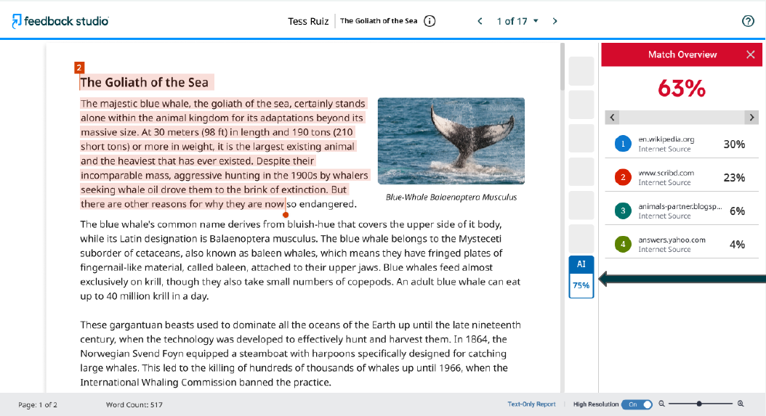
Turnitin – AI Detection
Similarity Score
AI Score not enabled for Uni of Auckland
AI Detection Score

Slide 7
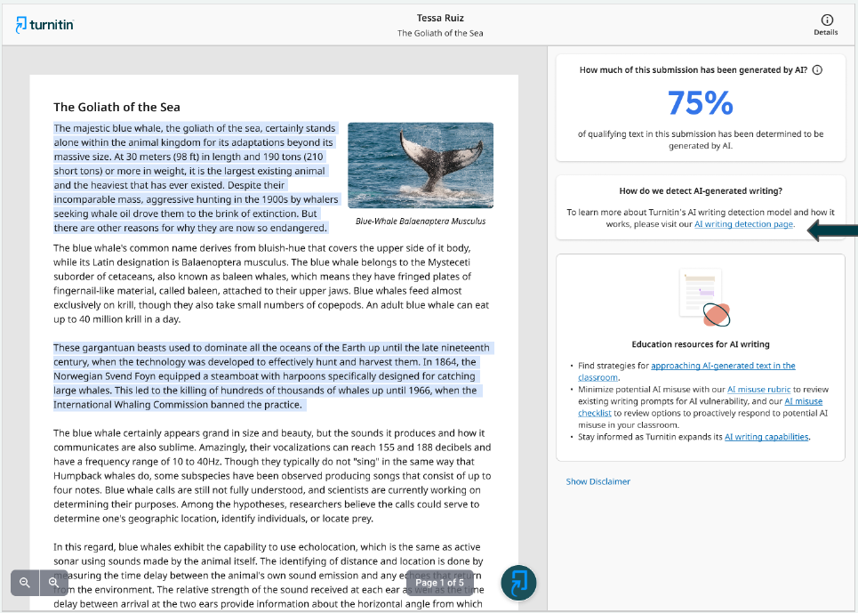
Turnitin – AI Detection
AI Detection Score
AI detection not enabled for Uni of Auckland
AI report highlights the text segments that Turnitin model predicts were written by AI
Link to FAQ page to provide additional information
Turnitin pedagogical resources to support educators

Slide 8
Turnitin – AI Detection
Decision to delay
Lack of transparency on how the tool detects AI content (unlike in similarity report where source content is linked)
Additional time to provide communications and guidance to teaching staff on how to use the AI detection score
  AI detection score by itself is not enough evidence of academic misconduct
Learn from other institutions will be trialing the tool

Slide 9
Thank you

